Slide 1
Module 14: Natural Language Processing

Slide 2
Neural Networks and Neural LMs
Jurafsky and Martin Chapters 7 and 9

Slide 3
Review: Feed-Forward Neural Network
The simplest kind of is the Feed-Forward Neural Network
Multilayer network, all units are usually fully-connected, and no cycles.
The outputs from each layer are passed to units in the next higher layer, and no outputs are passed back to lower layers.
Layer 2 (output layer)
Layer 1 (hidden layer)
Layer 0 (input layer)
Notes:
We’ll introduce networks with cycles, called recurrent neural networks Later. For historical reasons multilayer networks, especially feedforward networks, are sometimes called multi-layer perceptrons (or MLPs); this is a technical misnomer, since the units in modern multilayer networks aren’t perceptrons (perceptrons are purely linear, but modern networks are made up of units with non-linearities like sigmoids), but at some point the name stuck.
The core of the neural network is the hidden layer formed of hidden units, each of which is a neural unit, taking a weighted sum of its inputs and then applying a non-linearity. In the standard architecture, each layer is fully-connected, meaning that each unit in each layer takes as input the outputs from all the units in the previous layer, and there is a link between every pair of units from two adjacent layers. Thus each hidden unit sums over all the input units.

Slide 4
Andrew Ng

Slide 5
Review: Feed-Forward Neural Network
A single hidden unit has parameters w (the weight vector) and b (the bias scalar).
We represent the parameters for the entire hidden layer by combining the weight vector w_{i} and bias b_{i} for each unit i into a single weight matrix W and a single bias vector b for the whole layer.
Layer 2 (output layer)
Layer 1 (hidden layer)
Layer 0 (input layer)
Notes:
Each element Wi j of the weight matrix W represents the weight of the connection from the ith input unit xi to the jth hidden unit hj.

Slide 6
Review: Feed-Forward Neural Network
The advantage of using a single matrix W for the weights of the entire layer is the hidden layer computation can be done efficiently with simple matrix operations.
The computation has three steps:
1. multiplying the weight matrix by the input vector x, 2. adding the bias vector b, and 3. applying the activation function g (such as Sigmoid)
The output of the hidden layer, the vector h, is thus the following, using the sigmoid function σ:
h = σ(Wx+b)
Notes:
Notice that we’re applying the σ function here to a vector, while previously it was applied to a scalar. We’re thus allowing σ(·), and indeed any activation function g(·), to apply to a vector element-wise, so g[z1,z2,z3] = [g(z1),g(z2),g(z3)].

Slide 7
Review: Feed-Forward Neural Network
Like the hidden layer, the output layer has a weight matrix U. Its weight matrix is multiplied by its input vector (h) to produce the intermediate output z.
z=Uh
Layer 2 (output layer)
Layer 1 (hidden layer)
Layer 0 (input layer)
Notes:
Each element Wi j of the weight matrix W represents the weight of the connection from the ith input unit xi to the jth hidden unit hj.

Slide 8
Review: Feed-Forward Neural Network
Here are the final equations for a feedforward network with a single hidden layer, which takes an input vector x, outputs a probability distribution y, and is parameterized by weight matrices W and U and a bias vector b:
h = σ(Wx+b) z = Uh y = softmax(z)
Like with logistic regression, softmax normalizes the output and turns it into a probability distribution.
Notes:
Notice that we’re applying the σ function here to a vector, while previously it was applied to a scalar. We’re thus allowing σ(·), and indeed any activation function g(·), to apply to a vector element-wise, so g[z1,z2,z3] = [g(z1),g(z2),g(z3)].

Slide 9
Training Neural Nets
Like logistic regression, we want to learn the best parameters for the neural net to make its predictions $\hat{y}$ as close to possible as the gold standard labels in our training data y.
What do we need?
A loss function – cross-entropy loss
An optimization algorithm – gradient descent
A way of computing the gradient of the loss function – error propagation
Notes:
gradient descent requires knowing the gradient of the loss function, the vector that contains the partial derivative of the loss function with respect to each of the parameters. Here is one part where learning for neural networks is more complex than for logistic logistic regression. In logistic regression, for each observation we could directly compute the derivative of the loss function with respect to an individual w or b. But for neural networks, with millions of parameters in many layers, it’s much harder to see how to compute the partial derivative of some weight in layer 1 when the loss is attached to some much later layer. How do we partial out the loss over all those intermediate layers?
The answer is the algorithm called error backpropagation or reverse differentiation.

Slide 10
Cross-Entropy Loss
If the neural network is a binary classifier with a sigmoid at the final layer, the loss function is exactly the same as we saw in logistic regression:
$$LCE\left(\hat{y}, y\right)=−log p\left(y | x\right){=−[y\log{\hat{y}+\left(1 −y\right)\log{(1 − \hat{y}})]}}$$
Notes:
K in the denominator is the number of classes.

Slide 11
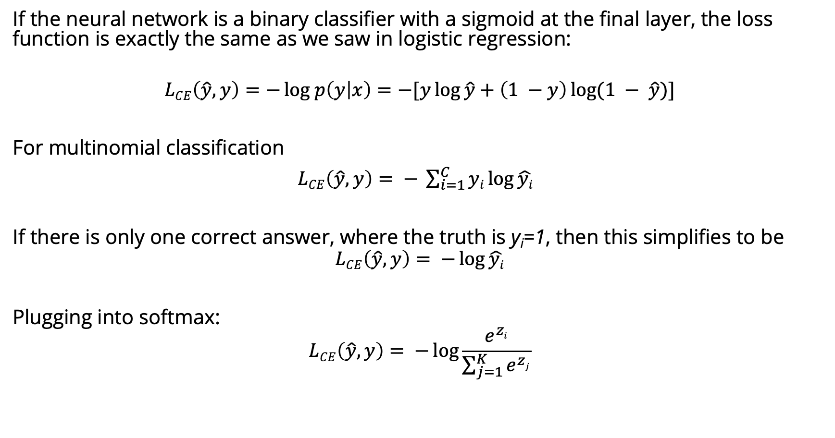
Cross-Entropy Loss
If the neural network is a binary classifier with a sigmoid at the final layer, the loss function is exactly the same as we saw in logistic regression:
$$LCE\left(\hat{y}, y\right)=−log p\left(y | x\right){=−[y\log{\hat{y}+\left(1 −y\right)\log{(1 − \hat{y}})]}}$$
For multinomial classification
$LCE\left(\hat{y}, y\right)= − \sum_{i=1}^{C}{yi\log{\hat{yi}} }$
If there is only one correct answer, where the truth is y_{i}=1, then this simplifies to be
$$LCE\left(\hat{y}, y\right)= −\log{\hat{yi}}$$
Plugging into softmax:
$$LCE\left(\hat{y}, y\right)= −\log{\frac{e^{zi}}{\sum_{j=1}^{K}{e^{zj}}}}$$
Notes:
K in the denominator is the number of classes.

Slide 12
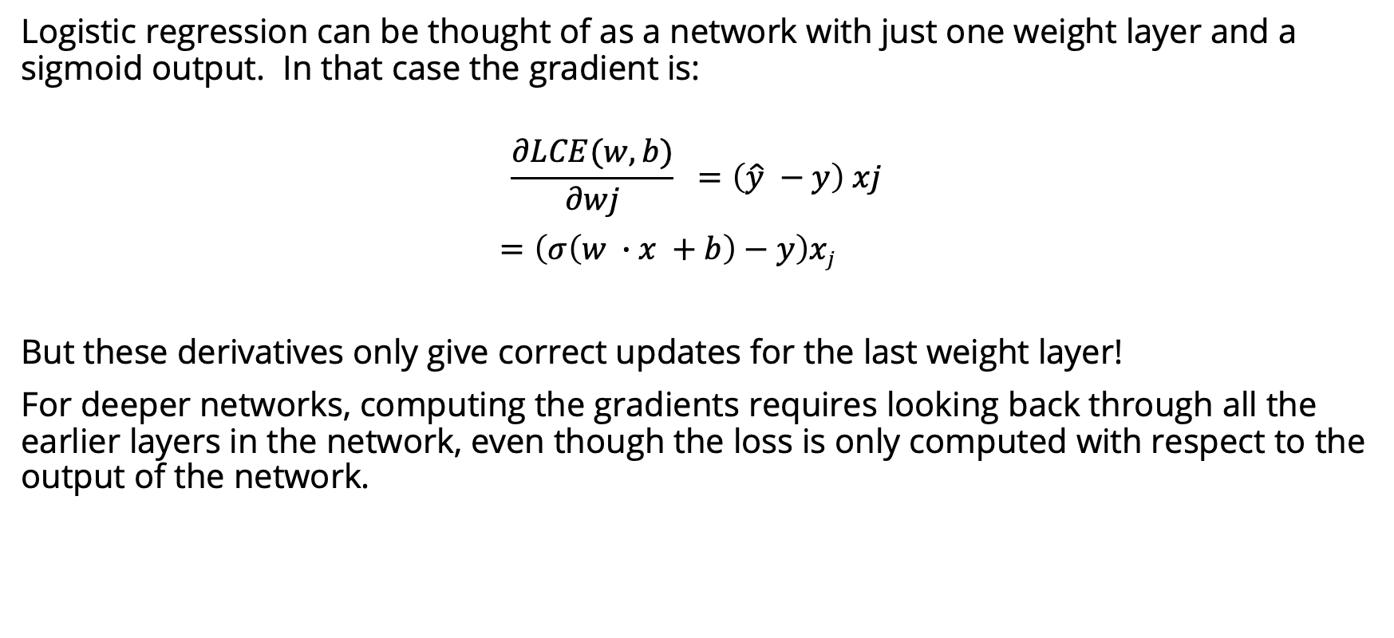
Computing the gradient
Logistic regression can be thought of as a network with just one weight layer and a sigmoid output. In that case the gradient is:
$$\frac{∂LCE(w,b)}{∂wj} =\left(\hat{y} −y\right) xj$$
$=\left(σ\left(w ∙x +b\right)−y\right)xj$
But these derivatives only give correct updates for the last weight layer!
For deeper networks, computing the gradients requires looking back through all the earlier layers in the network, even though the loss is only computed with respect to the output of the network.
Solution: error backpropagation algorithm

Slide 13
Computation Graphs
Although backpropagation was invented for neural nets, it is related to general procedure called backward differentiation, which depends on the notion of computation graphs.
A computation graph represents the process of computing a mathematical expression. The computation is broken down into separate operations. Each operation is a node in a graph.
L(a, b, c) = c(a + 2b)
d = 2∗b
e = a+d
L = c∗e
Notes:
If we make each of the component addition and multiplication operations explicit, and add names (d and e) for the intermediate outputs, the resulting series of computations is as shown on the righ.

Slide 14
Forward pass
L(a, b, c) = c(a + 2b)
d = 2∗b
e = a+d
L = c∗e
inputs a = 3, b = 1, c = −2,
Notes:
We can now represent this as a graph, with nodes for each operation, and directed edges showing the outputs from each operation as the inputs to the next, The simplest use of computation graphs is to compute the value of the function with some given inputs. For inputs a = 3, b = 1, c = −2, and we’ve shown the result of the forward pass to compute the result L(3, 1, −2) = 10. In the forward pass of a computation graph, we apply each operation left to right, passing the outputs of each computation as the input to the next node.

Slide 15
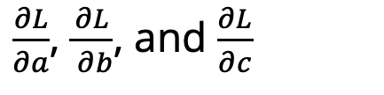
Backward differentiation
The importance of the computation graph comes from the backward pass, which is used to compute the derivatives that we’ll need for the weight update.
How do we compute the derivative of our output function L with respect to the input variables a, b, and c?
Backwards differentiation uses the chain rule from calculus.
$\frac{∂L}{∂a}$, $\frac{∂L}{ ∂b}$, and $\frac{∂L}{∂c}$
Notes:
The importance of the computation graph comes from the backward pass, which is used to compute the derivatives that we’ll need for the weight update. In this example our goal is to compute the derivative of the output function L with respect to each of the input variables, i.e., ∂L/∂a ∂L/∂b , and
∂L/∂c .
The derivative ∂L/∂a , tells us how much a small change in a affects L.

Slide 16
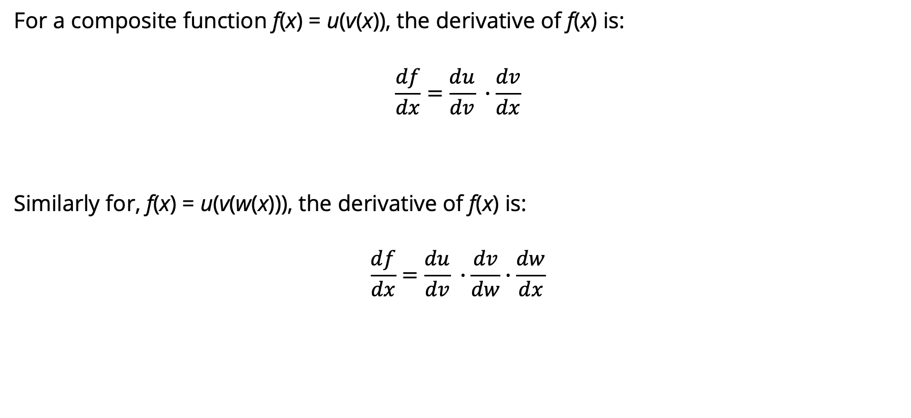
Chain rule
For a composite function f(x) = u(v(x)), the derivative of f(x) is:
$$\frac{df}{dx}=\frac{du}{dv} ∙\frac{dv}{dx}$$
Similarly for, f(x) = u(v(w(x))), the derivative of f(x) is:
$$\frac{df}{dx}=\frac{du}{dv} ∙\frac{dv}{dw}∙\frac{dw}{dx}$$
Notes:
Suppose we are computing the derivative of a composite function f (x) = u(v(x)). The derivative of f (x) is the derivative of u(x) with respect to v(x) times the derivative of v(x) with respect to x.

Slide 17
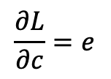
$$\frac{∂L}{∂c}=e$$
Notes:
Let’s now compute the 3 derivatives we need. Since in the computation graph L = ce, we can directly compute the derivative ∂L/∂c For the other two, we’ll need to use the chain rule. thus requires five intermediate derivatives. the derivative of a sum is the sum of the derivatives.

Slide 18
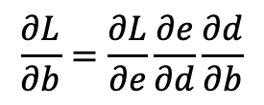
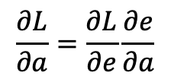
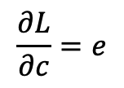
$$\frac{∂L}{∂a}=\frac{∂L}{∂e}\frac{∂e}{∂a}$$
$$\frac{∂L}{∂b}=\frac{∂L}{∂e}\frac{∂e}{∂d}\frac{∂d}{∂b}$$
$$\frac{∂L}{∂c}=e$$
Notes:
Let’s now compute the 3 derivatives we need. Since in the computation graph L = ce, we can directly compute the derivative ∂L/∂c For the other two, we’ll need to use the chain rule. thus requires five intermediate derivatives. the derivative of a sum is the sum of the derivatives.

Slide 19
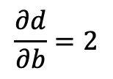
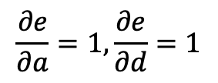
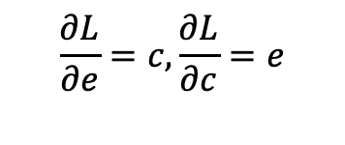
$$\frac{∂L}{∂a}=\frac{∂L}{∂e}\frac{∂e}{∂a}$$
$$\frac{∂e}{∂a}=1,\frac{∂e}{∂d}=1$$
$$\frac{∂L}{∂b}=\frac{∂L}{∂e}\frac{∂e}{∂d}\frac{∂d}{∂b}$$
$$\frac{∂d}{∂b}=2$$
$$\frac{∂L}{∂e}=c, \frac{∂L}{∂c}=e$$
$$\frac{∂L}{∂c}=e$$
Notes:
Let’s now compute the 3 derivatives we need. Since in the computation graph L = ce, we can directly compute the derivative ∂L/∂c For the other two, we’ll need to use the chain rule. thus requires five intermediate derivatives. the derivative of a sum is the sum of the derivatives.

Slide 20
Backward pass
Notes:
In the backward pass, we compute each of these partials along each edge of the graph from right to left, multiplying the necessary partials to result in the final derivative we need. Thus we begin by annotating the final node with ∂ L /∂ L = 1. Moving to the ∂L left, we then compute ∂ L/∂ c and ∂ L/∂ e , and so on, until we have annotated the graph all the way to the input variables. The forward pass conveniently already will have computed the values of the forward intermediate variables we need (like d and e) to compute these derivatives. In this figure, At each node we need to compute the local partial derivative with respect to the parent, multiply it by the partial derivative that is being passed down from the parent, and then pass it to the child.

Slide 21
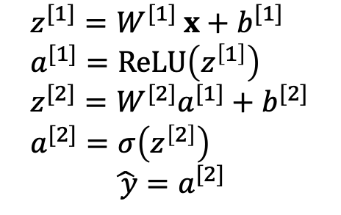
Computation Graph for a NN
$$z^{[1]}=W^{[1]} x+b^{[1]} \\ a^{[1]}=ReLU\left(z^{\left[1\right]}\right) \\ z^{[2]}=W^{[2]}a^{[1]}+b^{[2]} \\ a^{[2]}=σ\left(z^{\left[2\right]}\right)$$
$\hat{ y}=$ $a^{[2]}$
Notes:
This shows a sample computation graph for a 2-layer neural network with layers of sizen0 = 2, n1 = 2, and n2 = 1. Assuming binary classification and hence using a sigmoid output unit for simplicity. The function that the computation graph is computing is: given by these equations in the lower right.
he weights that need updating (those for which we need to know the partial derivative of the loss function) are shown in orange. In order to do the backward pass, we’ll need to know the derivatives of all the functions in the graph. The derivative of the sigmoid σ :
dσ(z)/dz = σ(z)(1−σ(z))

Slide 22
NLP: Vector Semantics
Jurafsky and Martin Chapter 6

Slide 23
Word Meaning
How should we represent the meaning of a word?
In N-gram LMs we represented words as a string of letters or as an index in a vocabulary list.
Ideally, we want a meaning representation to encode:
Synonyms – words that have similar meanings
Antonyms – words that have opposite meanings
Connotations – words that are positive or negative
Semantic Roles – buy, sell, and pay are different parts of the same underlying purchasing event
Support for entailment
Notes:
(If I buy something from you, you’ve probably sold it to me, and I likely paid you).

Slide 24
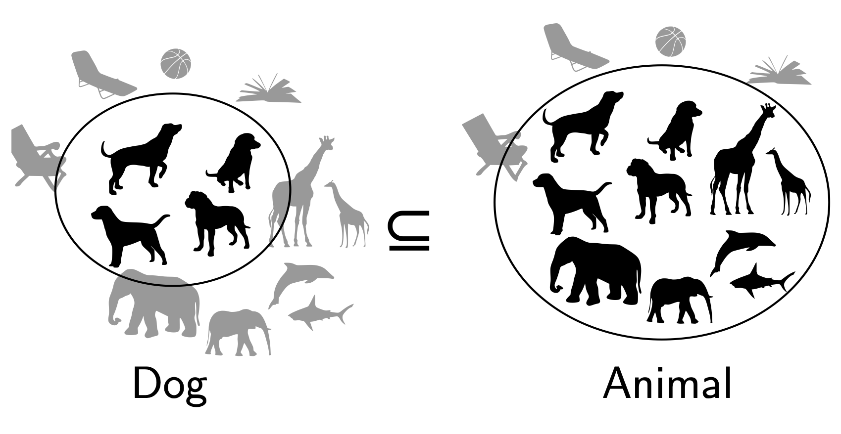
Entailment in formal semantics

Slide 25
Entailment in formal semantics
All animals have an ulnar artery
⇒
All dogs have an ulnar artery
+ Mathematically well-understood + Powerful machinery for handling logical operations
- Knowledge must come from somewhere else

Slide 26
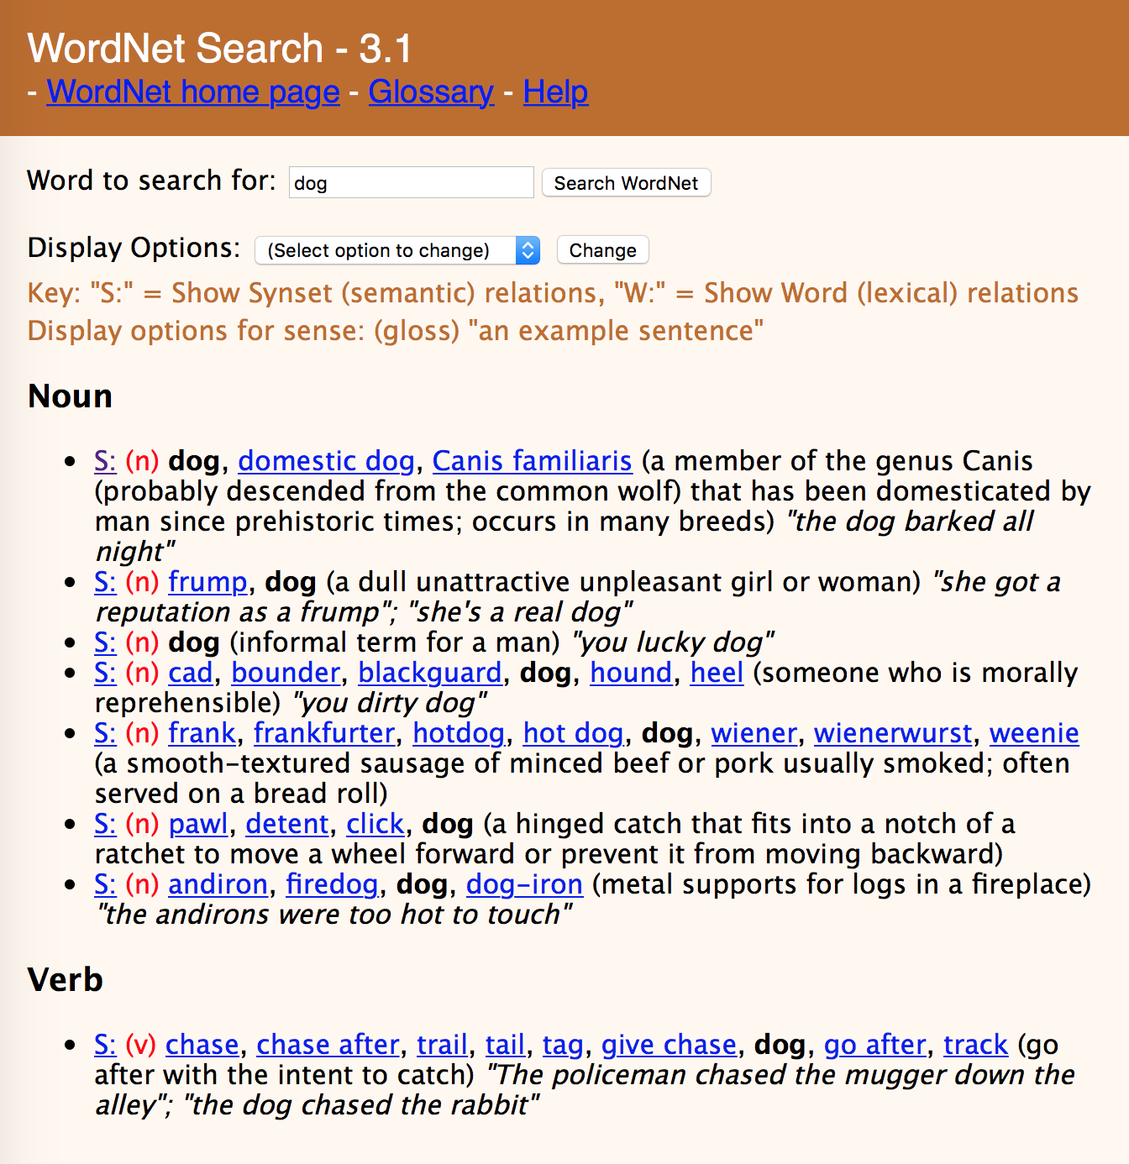

Slide 29
Lexical Semantics
act
communicate
perform
address
relay
practice
harangue
talk about
walk through
scrimmage
rant
descant
WordNet

Slide 30
Lexical Semantics
act
communicate
perform
address
relay
practice
harangue
talk about
walk through
scrimmage
rant
descant
WordNet
Vector Space Models
Notes:
VSMs have several attractive properties. VSMs extract knowledge automatically from a given corpus, thus they require much less labour than other approaches to semantics, such as hand-coded knowledge bases and ontologies.

Slide 31
Vector Space Models
Notes:
The idea of the VSM is to represent each word as a point in a space (a vector in a vector space). Points that are close together in this space are semantically similar and points that are far apart are semantically distant.

Slide 32
Dictionary Definitions
Noun
A small insect.
A harmful microorganism, as a bacterium or virus.
An enthusiastic, almost obsessive, interest in something. ‘they caught the sailing bug’
A miniature microphone, typically concealed in a room or telephone, used for surveillance.
An error in a computer program or system.
Verb
Conceal a miniature microphone in (a room or telephone) in order to monitor or record someone's conversations.
Annoy or bother (someone)
Notes:
Here the form bug is the lemma, also called the citation form. The form bug would also be the lemma for the word bugs; dictionaries don’t have separate definitions for inflected forms. Similarly sing is the lemma for sing, sang, sung. In many languages the infinitive form is used as the lemma for the verb, so Spanish dormir “to sleep” is the lemma for duermes “you sleep”. The specific forms sung or carpets or sing or duermes are called wordforms.

Slide 33
Polysemy
A word that has multiple meanings is called polysemous. We call each of these aspects of the meaning of bug a word sense.
Polysemy can make interpretation difficult.
What if someone types “caught a bug” into Google?
Word sense disambiguation is the task of determining which sense of a word is being used in a context.

Slide 34
Synonymy
When one word has a sense whose meaning is nearly identical to a sense of another word then those two words are synonyms.
glitch/error
microbe/bacterium
insect/pest
microphone/wire
Formally, two words are synonymous if they are substitutable one for the other in any sentence without changing the truth conditions of the sentence.
In logic, that means the two words carry the same propositional meaning.
Notes:
That means that all the situations in which the original sentence would be true, the sentence with the substitution would also be true.

Slide 35
Principle of Contrast
Linguists assume that a difference in form is always associated with a difference in meaning.
While substitutions like water/H₂O or father/dad are truth preserving, the words are still not identical in meaning.
H₂O is used in scientific contexts, but not general texts like hiking guides
Father is a more formal version of dad.
It is possible that no two words have absolutely identical meaning.

Slide 36
Word similarity
Most words don’t have many synonyms, but they do have a lot of similar words. Cat is not a synonym of dog, but cats and dogs are certainly similar words.
“fast” is similar to “rapid”
“tall” is similar to “height”
Useful for applications like question answering
Notes:
In moving from synonymy to similarity, it will be useful to shift from talking about relations between word senses (like synonymy) to relations between words (like similarity). Dealing with words avoids having to commit to a particular representation of word senses, which will turn out to simplify our task.

Slide 37
Word similarity
Most words don’t have many synonyms, but they do have a lot of similar words. Cat is not a synonym of dog, but cats and dogs are certainly similar words.
“fast” is similar to “rapid”
“tall” is similar to “height”
Useful for applications like Question Answering
Notes:
In moving from synonymy to similarity, it will be useful to shift from talking about relations between word senses (like synonymy) to relations between words (like similarity). Dealing with words avoids having to commit to a particular representation of word senses, which will turn out to simplify our task.

Slide 38
Word similarity
Can similar words be substituted in any sentence without changing its truth conditions? No.
How can we measure whether words are similar? One way is to ask humans to judge how similar one word is to another.
Word 1 | Word 2 | Similarity Score
Vanish | Disappear | 9.8
Tiger | Cat | 7.4
Love | Sex | 6.8
Muscle | Bone | 3.6
Cucumber | Professor | 0.3
Notes:
SimLex-999 dataset (Hill et al., 2015) gives values on a scale from 0 to 10, like the examples below, which range from near-synonyms (vanish, disappear) to pairs that scarcely seem to have anything in common (hole, agreement):

Slide 39
Word Relatedness
Words can still be related in ways other than being similar to each other.
Coffee and Cup are not similar because they don’t share any features
coffee is a plant or a beverage,
cup is a manufactured object made in a useful shape
But they’re related by co-participating in the same event.
Relatedness is measured with word association tests in psychology.
A semantic field is a set of words which cover a semantic domain and bear structured relations with each other.
Hospitals: surgeon, scalpel, nurse, anesthetic, hospital Restaurants: waiter, menu, plate, food, chef Houses: family, door, roof, kitchen, bed

Slide 40
Semantic Roles
An event like a commercial transaction described with different verbs
buy (the event from the perspective of the buyer),
sell (from the perspective of the seller),
pay (focusing on the monetary aspect),
Or with nouns like buyer.
Frames encode semantic roles (like buyer, seller, goods, money), and the words in a sentence that take on these roles.
Notes:
Closely related to semantic fields is the idea of a semantic frame. A semantic frame is a set of words that denote perspectives or participants in a particular type of event.
Knowing that buy and sell have this relation makes it possible for a system to know that a sentence like Sam bought the book from Ling could be paraphrased as Ling sold the book to Sam, and that Sam has the role of the buyer in the frame and Ling the seller. Being able to recognize such paraphrases is important for question answering, and can help in shifting perspective for machine translation.

Slide 41
Connotation
Words have affective meanings or connotations. Three important dimensions of affective meaning.
Valence – the pleasantness of the stimulus
Arousal – the intensity of emotion provoked by the stimulus
Dominance – the degree of control exerted by the stimulus
 | Valence | Arousal | Dominance
courageous | 8.05 | 5.5 | 7.38
music | 7.67 | 5.57 | 6.5
heartbreak | 2.45 | 5.65 | 3.58
cub | 6.71 | 3.95 | 4.24
life | 6.68 | 5.59 | 5.89

Slide 42
Points in space
Osgood et al. (1957) noticed that in using these 3 numbers to represent the meaning of a word, the model was representing each word as a point in a three-dimensional space
Part of the meaning of heartbreak can be represented as a vector with three dimensions corresponded to the word’s rating on the three scales.
heartbreak | 2.45 | 5.65 | 3.58

Slide 43
Vector Space Models
Notes:
The idea of the VSM is to represent each word as a point in a space (a vector in a vector space). Points that are close together in this space are semantically similar and points that are far apart are semantically distant.

Slide 44
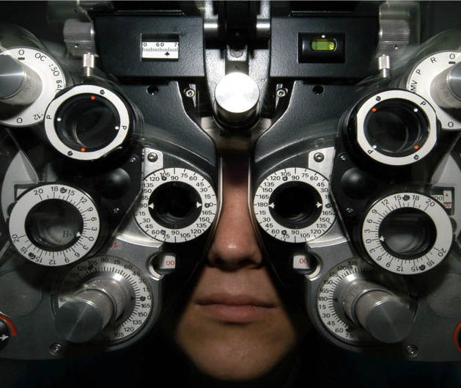
Distributional Hypothesis
If we consider optometrist and eye-doctor we find that, as our corpus of utterances grows, these two occur in almost the same environments. In contrast, there are many sentence environments in which optometrist occurs but lawyer does not...
It is a question of the relative frequency of such environments, and of what we will obtain if we ask an informant to substitute any word he wishes for optometrist (not asking what words have the same meaning).
These and similar tests all measure the probability of particular environments occurring with particular elements... If A and B have almost identical environments we say that they are synonyms.
–Zellig Harris (1954)
Notes:
Similar messages expressed by Wittgenstein (1953) and Firth (1957) who said “You shall know a word by the company it keeps.”
VSMs are interesting especially due to their relation with the distributional hypothesis and related hypotheses. The distributional hypothesis is that words that occur in similar contexts tend to have similar meanings. Efforts to apply this abstract hypothesis to concrete algorithms for measuring the similarity of meaning often lead to vectors, matrices, and higher-order tensors.

Slide 45
Intuition of distributional word similarity
Nida (1975) example: A bottle of tesgüino is on the table Everybody likes tesgüino Tesgüino makes you drunk We make tesgüino out of corn.
From context words humans can guess tesgüino means an alcoholic beverage like beer
Intuition for algorithm: Two words are similar if they have similar word contexts.

Slide 46
History of Vector Space Models
Vector Space Models were initially developed in the SMART information retrieval system (Salton, 1971)
Each document in a collection is represented as point in a space (a vector in a vector space)
A user’s query is a pseudo-document and is represented as a point in the same space as the documents
Perform IR by retrieving documents whose vectors are close together in this space to the query vector

Slide 47
Term-Document Matrix
 | D1 | D2 | D3 | D4 | D5
abandon
abdicate
abhor
academic
…
zygodactyl
zymurgy
Notes:
Documents can be things like Shakespeare’s plays, or novels, or web pages

Slide 48


Term-Document Matrix
 | D1 | D2 | D3 | D4 | D5
abandon
abdicate
abhor
academic
…
zygodactyl
zymurgy
Each column vector
represents a Document
Notes:
Documents can be things like Shakespeare’s plays, or Wikipedia pages, or IMDB reviews for a movie.

Slide 49
Term-Document Matrix
 | D1 | D2 | D3 | D4 | D5
abandon
abdicate
abhor
academic
…
zygodactyl
zymurgy
Each row vector
represents a Term

Slide 50


Term-Document Matrix
 | D1 | D2 | D3 | D4 | D5
abandon
abdicate
abhor
academic
…
zygodactyl
zymurgy
The value in a cell is
based on how often that term
occurred in that document

Slide 51

Term-Document Matrix
}
 | D1 | D2 | D3 | D4 | D5
abandon
abdicate
abhor
academic
…
zygodactyl
zymurgy
The length of the
document vectors
is the size of the vocabulary

Slide 52
Term-Document Matrix
 | D1 | D2 | D3 | D4 | D5
abandon
abdicate
abhor
academic
…
zygodactyl
zymurgy
Document vectors
can be sparse
(most values are 0)

Slide 53


Term-Document Matrix
 | D1 | D2 | D3 | D4 | D5
abandon
abdicate
abhor
academic
…
zygodactyl
zymurgy
We can measure
how similar two
documents are
by comparing their
column vectors

Slide 54
What can document similarity let you do?

Slide 55
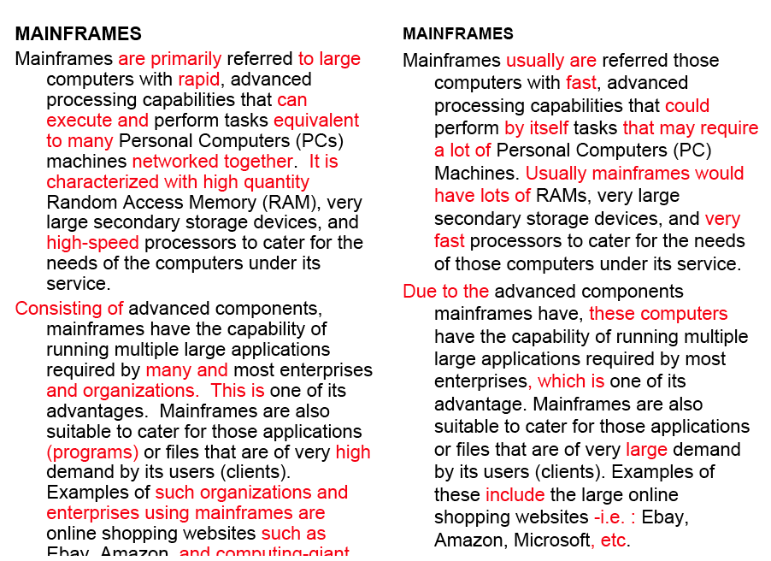
Word similarity for plagiarism detection

Slide 56



Term-Document Matrix
 | D1 | D2 | D3 | D4 | D5
abandon
abdicate
abhor
academic
…
zygodactyl
zymurgy
What does comparing
two row vectors do?
Notes:
It measures the similarity between words!

Slide 57
Vector comparisons
 | docX | docY
A | 2 | 4
B | 10 | 15
C | 14 | 10
Notes:
docY is a positive movie review
docx is a less positive movie review
A = "superb" positive / low frequency
B = "good" positive / high frequency
C = "disappointing" negative / high frequency

Slide 58
Vector comparisons
 | docX | docY
A | 2 | 4
B | 10 | 15
C | 14 | 10
docY is a positive movie review
docx is a less positive movie review
A = "superb" positive / low frequency
B = "good" positive / high frequency
C = "disappointing" negative / high frequency
Notes:
docY is a positive movie review
docx is a less positive movie review
A = "superb" positive / low frequency
B = "good" positive / high frequency
C = "disappointing" negative / high frequency

Slide 59
Vector comparisons
 | docX | docY
A | 2 | 4
B | 10 | 15
C | 14 | 10
Notes:
Euclidean distance : vectors u, v of dimension N
sqrt (sum_i to N ( | ui - vi|² ) )
A to B is sqrt of | 2-10 |² + | 4-15 |² = 13.6
B to C is sqrt of | 10-14 |² + | 15-10 |² = 6.4
A = Superb, B = Good, C=Disappointing
Goal: related words are close, and unrelated words are far apart.
Did we do it?

Slide 60
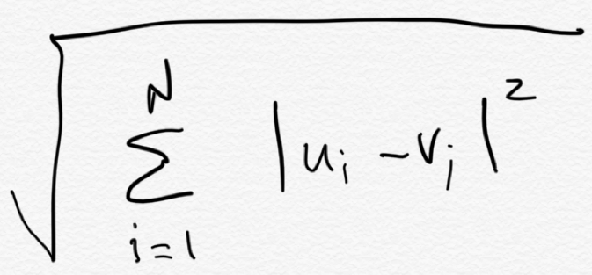
Vector comparisons
Euclidean distance
 | docX | docY
A | 2 | 4
B | 10 | 15
C | 14 | 10
B
distance = 6.4
distance = 13.6
C
Euclidean distance : vectors u, v of dimension N
A

Slide 61
Vector comparisons
Oh no! Good is
closer to Disappointing
than to Superb.
Euclidean distance
 | docX | docY
A | 2 | 4
B | 10 | 15
C | 14 | 10
B = Good
distance = 6.4
distance = 13.6
C = Disappointing
Euclidean distance : vectors u, v of dimension N
A = Superb

Slide 62
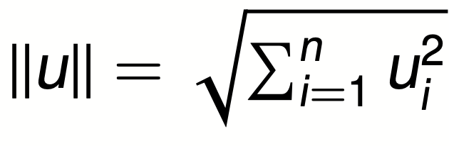
Vector L2 (length) Normalization
 | docX | docY
A | 2 | 4
B | 10 | 15
C | 14 | 10
||u||
4.47
18.02
17.20

Slide 63
Vector L2 (length) Normalization
 | docX | docY
A | 2/4.47 | 4/4.47
B | 10/18.02 | 15/18.02
C | 14/17.2 | 10/17.2
||u||
4.47
18.02
17.20
Divide each vector by its L2 length

Slide 64
Vector comparisons
 | docX | docY
A | 2 | 4
B | 10 | 15
C | 14 | 10
Notes:
Euclidean distance : vectors u, v of dimension N
sqrt (sum_i to N ( | ui - vi|² ) )
A to B is sqrt of | 2-10 |² + | 4-15 |² = 13.6
B to C is sqrt of | 10-14 |² + | 15-10 |² = 6.4
A = Superb, B = Good, C=Disappointing
Goal: related words are close, and unrelated words are far apart.
Did we do it?

Slide 65
Vector L2 (length) Normalization
 | docX | docY
Ȧ | 0.45 | 0.89
Ḃ | 0.55 | 0.83
Ċ | 0.81 | 0.58
A = Superb
B = Good
C = Disappointing
Now Good is
closer to Superb
than to Disappointing

Slide 66
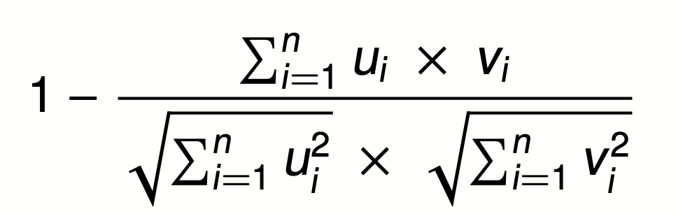

Cosine Distance
A = Superb
B = Good
C = Disappointing
Cosine does the L2
normalization too
Cosine angle between
vectors tells us their similarity

Slide 67
Term-Term Matrix
 | abandon | abdicate | abhor | … | zymurgy
abandon
abdicate
abhor
academic
…
zygodactyl
zymurgy
Notes:
Defines a co-occurrence matrix
w-2, w-1 target word w+1 w+2

Slide 68
Term-Term Matrix
AKA Term-Context Matrix
 | abandon | abdicate | abhor | … | zymurgy
abandon
abdicate
abhor
academic
…
zygodactyl
zymurgy
Length of the vector is now |V|
instead of number of documents
Notes:
|V| = size of vocabulary

Slide 69
Term-Term Matrix
AKA Term-Context Matrix
 | abandon | abdicate | abhor | … | zymurgy
abandon
abdicate
abhor
academic
…
zygodactyl
zymurgy
The value in a cell indicates how
often abandon appears in a
context window surrounding
abdicate
Notes:
Defines a co-occurrence matrix
w-2, w-1 target word w+1 w+2

Slide 70
Context windows
w-2, w-1 target_word w+1 w+2
The government most not abdicate responsibility to non-elected
it has led men to abdicate their family responsibilities
other demands, but declining to abdicate his responsibility
leaders abdicate their role and present people with no plans
 | his | leaders | not | responsibility | to
abdicate | 1 | 1 | 1 | 2 | 3
Notes:
Defines a co-occurrence matrix
w-2, w-1 target word w+1 w+2

Slide 71
Context windows
Occur in a window of +/- 2 words, in the same sentence, in the same document
Instead of window of words use more complex contexts: dependency patters. Subj-of-verb, adj-mod, obj-of-verb
Languages have long distance dependencies The pictures are beautiful. The pictures of the old man are beautiful. The pictures of the old man holding his grandchild are beautiful.
Notes:
Defines a co-occurrence matrix
w-2, w-1 target word w+1 w+2

Slide 72
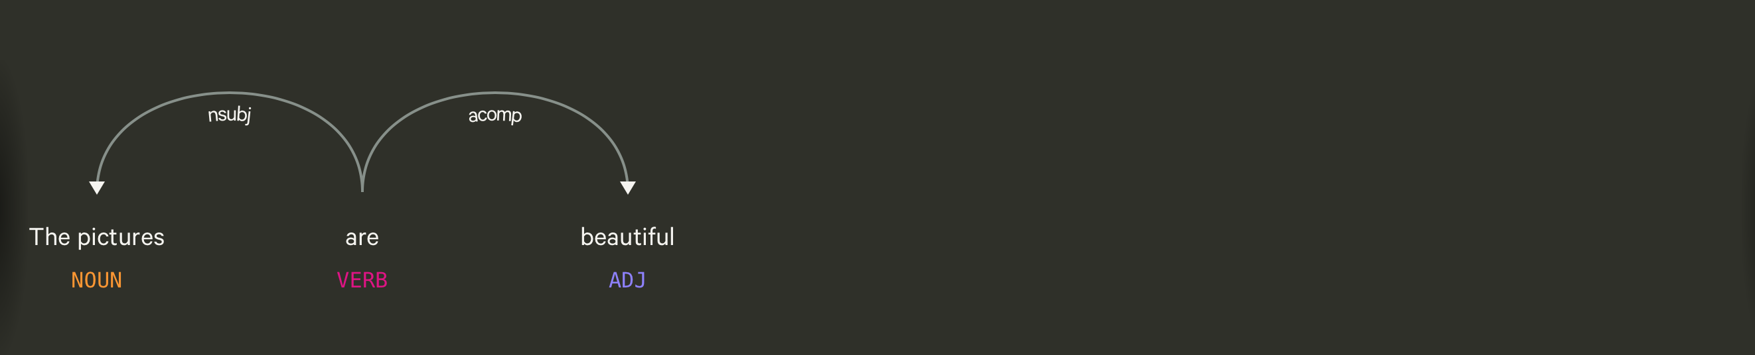
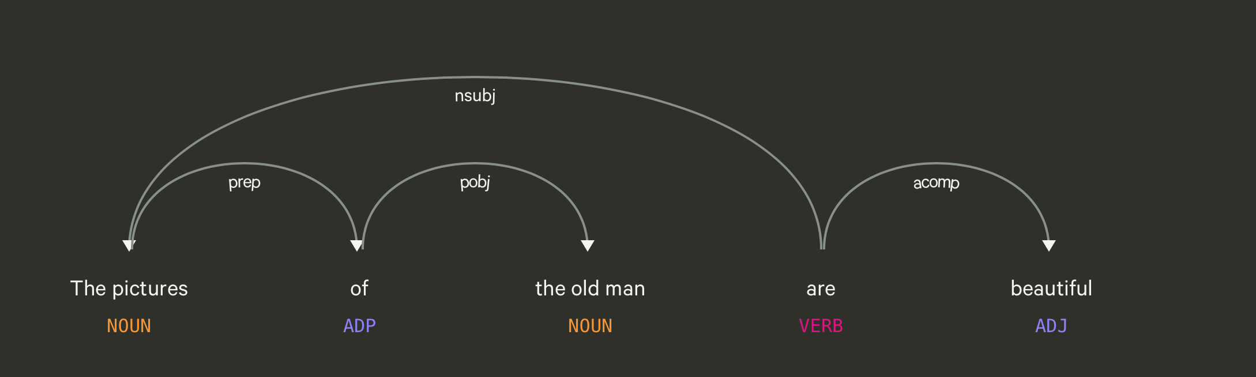
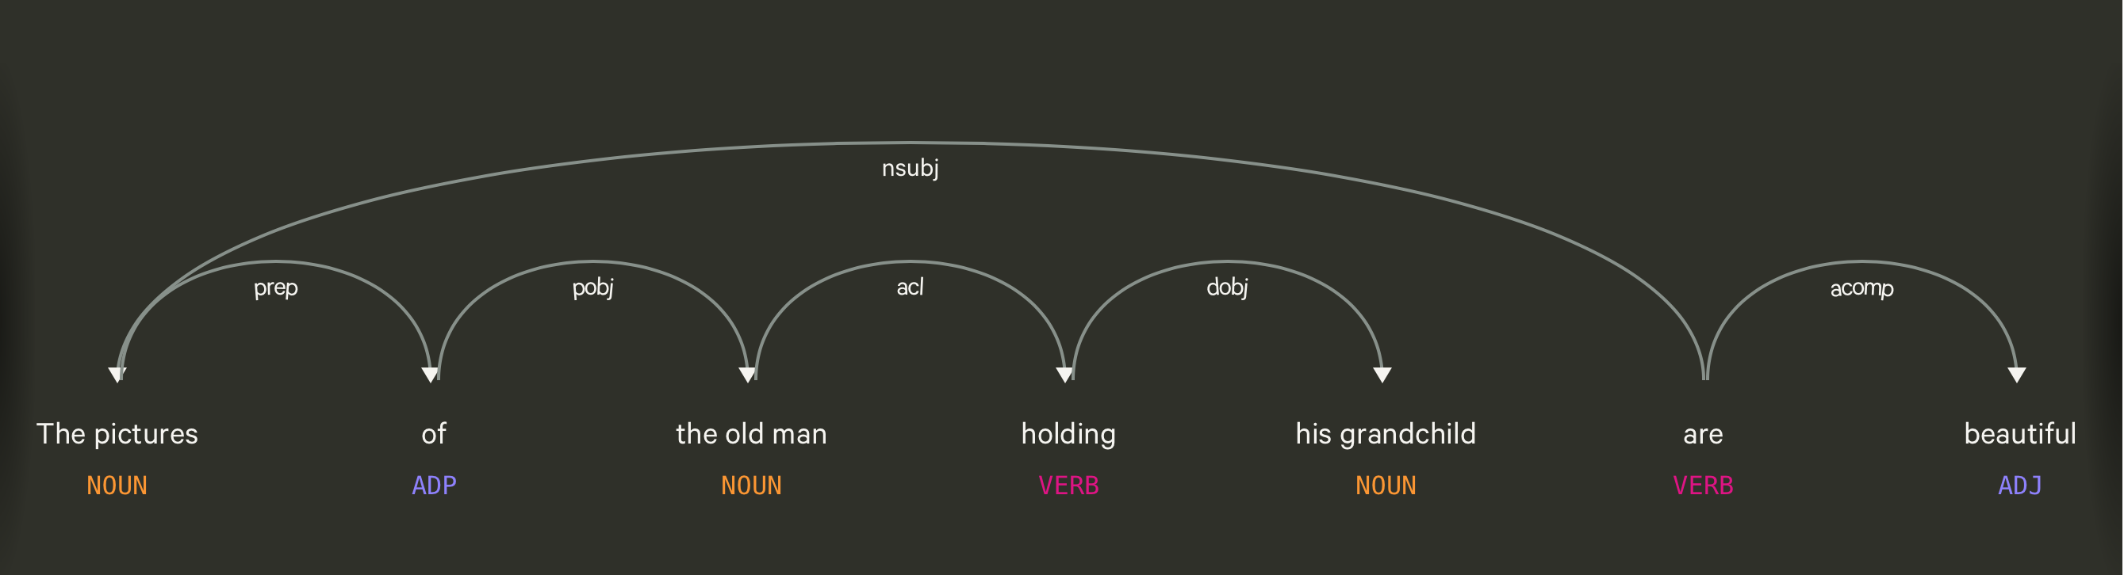

Slide 73
Using syntax to define a word’s context
Zellig Harris (1968) “The meaning of entities, and the meaning of grammatical relations among them, is related to the restriction of combinations of these entities relative to other entities”
Duty and Responsibility have similar syntactic distributions
Modified by adjectives | additional, administrative, assumed, collective, congressional, constitutional …
Object of verbs | assert, assign, assume, attend to, avoid, become, breach..

Slide 74
Alternates to counts
Raw word frequency is not a great measure of association between words. It’s very skewed “the” and “of” are very frequent, but maybe not the most discriminative
We’d rather have a measure that asks whether a context word is particularly informative about the target word.
Instead of raw counts, it’s common to transform vectors using TF-IDF or PPMI
Notes:
I’m going to skip the definition of PPMI for this talk

Slide 75


TF-IDF
Term frequency * inverse document frequency
How often a
word occurred in
a document
1 over the number
of documents that it
occurred in
Notes:
What does this do to a word like the?

Slide 76
Sparse v. Dense Vectors
Co-occurrence matrix (weighted by TF-IDF or mutual information)
Long (length |V| = 50,000+)
Sparse (most elements are zeros)
Alternative: learn vectors that are
Short (length 200-1000)
Dense (most elements are non-zero)
Notes:
ccb - future todo - Re-work as a visual?

Slide 77
Neural Language Models

Slide 78
Neural Language Models
Jurafsky and Martin Chapters 7 and 9

Slide 79
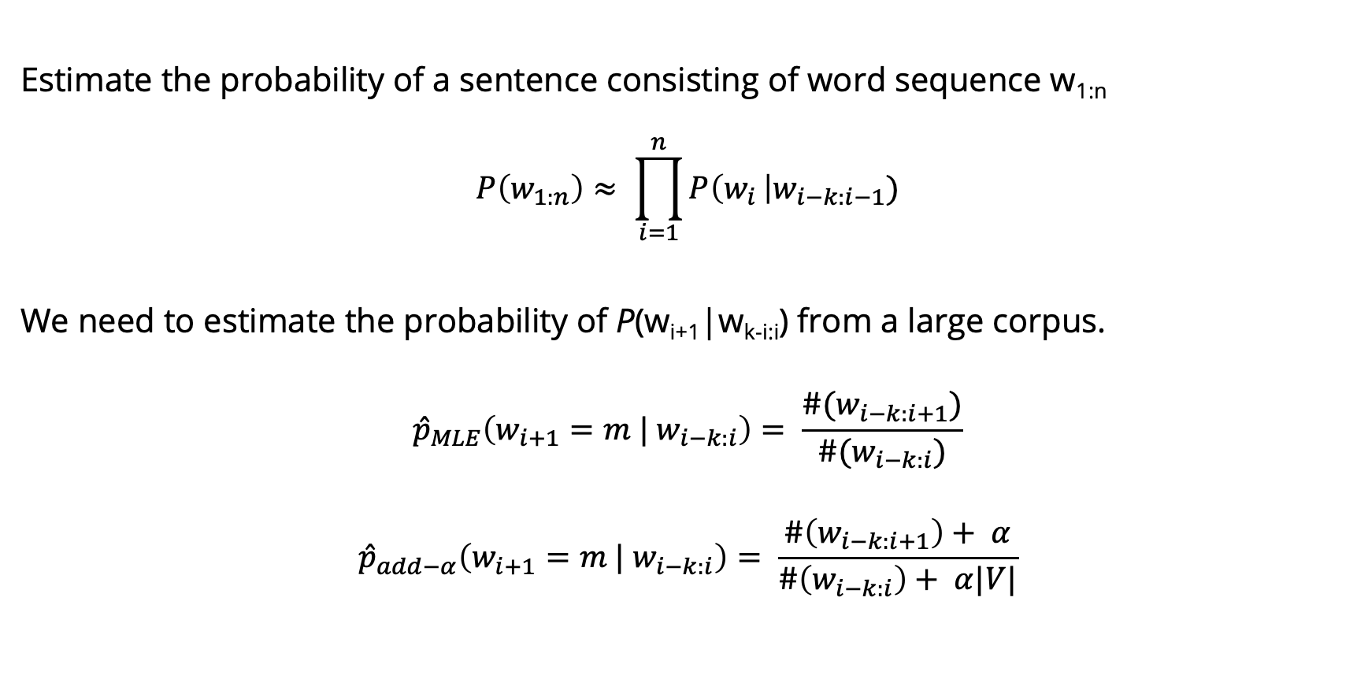
Language Models
Estimate the probability of a sentence consisting of word sequence w_{1:n}
$$P\left(w_{1:n}\right)≈ \prod_{i=1}^{n}{P\left(w_{i }\right|w_{i−k:i−1})}$$
We need to estimate the probability of P(w_{i+1}|w_{k-i:i}) from a large corpus.
$${\hat{p}}_{MLE}\left(w_{i+1}=m | w_{i−k:i}\right)= \frac{\#(w_{i−k:i+1})}{\#(w_{i−k:i})}$$
$${\hat{p}}_{add−α}\left(w_{i+1}=m | w_{i−k:i}\right)= \frac{\#\left(w_{i−k:i+1}\right)+ α}{\#\left(w_{i−k:i}\right)+ α|V|}$$

Slide 80
Language Modeling
Goal: Learn a function that returns the joint probability
Primary difficulty:
There are too many parameters to accurately estimate. This is sometimes called the “curse of dimensionality”
In n-gram-based models we fail to generalize to related words / word sequences that we have observed.

Slide 81
Curse of dimensionality / sparse statistics
Suppose we want a joint distribution over 10 words. Suppose we have a vocabulary of size 100,000.
100,000¹⁰ =10⁵⁰ parameters
This is too high to estimate from data.

Slide 82
Chain rule
In LMs we user chain rule to get the conditional probability of the next word in the sequence given all of the previous words:
$P(w_{1}w_{2}w_{3}$…$w_{t})= \prod_{t=1}^{T}{P(w_{t}|}w_{1}$…$w_{t−1})$
What assumption do we make in n-gram LMs to simplify this?
The probability of the next word only depends on the previous n-1 words.
A small n makes it easier for us to get an estimate of the probability from data.

Slide 83
Probability tables
We construct tables to look up the probability of seeing a word given a history.
The tables only store observed sequences.
What happens when we have a new (unseen) combination of n words?
curse of | P(w_{t} | w_{t-n} … w_{t-1})
dimensionality
azure
knowledge
oak
Notes:
“Stupid” multinomial distributions == table lookup.

Slide 84
Unseen sequences
What happens when we have a new (unseen) combination of n words?
Back-off
Smoothing / interpolation
We are basically just stitching together short sequences of observed words.

Slide 85
Alternate idea
Let’s try generalizing.
Intuition: Take a sentence like
The cat is walking in the bedroom
And use it when we assign probabilities to similar sentences like
The dog is running around the room
Notes:
Draw vectors under the words.
Write out: sim(cat, dog)

Slide 86
Neural Language Models
Neural Language models have several advantages over n-gram LMs:
1. They don’t need smoothing
2. They can handle much longer histories.
3. They can generalize over contexts of similar words.
4. Neural LMs tend to have much higher predictive accuracy than n-gram LMs.
Disadvantage: slower to train than traditional n-gram LMs

Slide 87
Neural LMs
In neural LMs, the prior context is represented by embeddings. This allows neural LMs to generalize better than n-gram LMs.
Imagine in training we have seen
I have to make sure when I get home to feed the cat.
But we’ve never seen “feed the dog” in training. If in the test set, we want to predict the next word after
I forgot when I got home to feed the ____
An n-gram LM will only predict cat, but a neural LM will know that the embeddings for cat and dog are similar.
Notes:
In neural language models, the prior context is represented by embeddings of the previous words. Representing the prior context as embeddings, rather than by ex- act words as used in n-gram language models, allows neural language models to generalize to unseen data much better than n-gram language models. For example, suppose we’ve seen this sentence in training:
Take an input and time t, represent some number of previous words (w_{t-1}, w_{t-2,} w_{t-3}), and output a probability distribution over the next word. P(w_{t} | w_{t-1}, w_{t-2,} w_{t-3}).

Slide 88
Neural LMs (Bengio et al 2003)
Associate each word in the vocabulary with a vector-representation, thereby creating a notion of similarity between words.
Express the joint probability function of a word sequence in terms of the word vectors for the words in that sequence.
Simultaneously learn the word vectors and the parameters of the function.
The word vectors are low-dimensional (d=30 to d=100) dense vectors, like we’ve seen before.
The probability function is expressed the product of conditional probabilities of the next word given the previous word, using a multi-layer, feed forward neural network.

Slide 89
Neural LMs
The input to the neural network is a k-gram of words w_{1:k}.
The output is a probability distribution over the next word.
The k context words are treated as a word window. Each word is associated with an embedding vector:
The input vector x just concatenates v(w) for each of the k words:

Slide 90
Neural LMs
The input x is fed into a neural network with 1 or more hidden layers:
Notes:
V is a finite vocabulary, including the unique symbols U for unknown words, <s> for sentence initial padding, and </s> for end-of-sequence marking. e vocabulary size, jV j, ranges between 10,000–1,000,000 words, with the common sizes revolving around 70,000.

Slide 92
Training
The training examples are simply word k-grams from the corpus
The identities of the first k+1 words are used as features, and the last word is used as the target label for the classification.
Conceptually, the model is trained using cross-entropy loss.
Working with cross entropy loss works very well, but requires the use of a costly softmax operation which can be prohibitive for very large vocabularies, we we often use alternative loss functions or approximations.
Notes:
Large output spaces Working with neural probabilistic language models with large output spaces (i.e., efficiently computing the softmax over the vocabulary) can be prohibitive both at training time and at test time. Dealing with large output spaces efficiently is an active research question. Some of the existing solutions are as follows.
Hierarchical softmax [Morin and Bengio, 2005] allows to compute the probability of a single word in O.log jV j/ time rather than O.jV j/. is is achieved by structuring the softmax computation as tree traversal, and the probability of each word as the product of branch selection decisions. Assuming one is interested in the probability of a single word (rather than getting the distribution over all words) this approach provides clear benefits in both training and testing time. Self-normalizing aproaches, such as noise-contrastive estimation (NCE) [Mnih and Teh, 2012, Vaswani et al., 2013] or adding normalizing term to the training objective [Devlin et al., 2014]. e NCE approach improves training time performance by replacing the cross-entropy objective with a collection of binary classification problems, requiring the evaluation of the assigned scores for k random words rather than the entire vocabulary. It also improves test-time prediction by pushing the model toward producing “approximately normalized” exponentiated scores, making the model score for a word a good substitute for its probability. e normalization term approach of Devlin et al. [2014] similarly improves test time efficiency by adding a term to the training objective that encourages the exponentiated model scores to sum to one, making the explicit summation at test time unnecessary (the approach does not improve training time efficiency). Sampling Approaches approximate the training-time softmax over a smaller subset of the vocabu- lary [Jean et al., 2015].
A good review and comparison of these and other techniques for dealing with large output vocabularies is available in Chen et al. [2016].
An orthogonal line of work is attempting to sidestep the problem by working at the char- acters level rather than words level.

Slide 93
Training
The training examples are simply word k-grams from the corpus
The identities of the first k-1 words are used as features, and the last word is used as the target label for the classification.
Conceptually, the model is trained using cross-entropy loss.
Notes:
Large output spaces Working with neural probabilistic language models with large output spaces (i.e., efficiently computing the softmax over the vocabulary) can be prohibitive both at training time and at test time. Dealing with large output spaces efficiently is an active research question. Some of the existing solutions are as follows.
Hierarchical softmax [Morin and Bengio, 2005] allows to compute the probability of a single word in O.log jV j/ time rather than O.jV j/. is is achieved by structuring the softmax computation as tree traversal, and the probability of each word as the product of branch selection decisions. Assuming one is interested in the probability of a single word (rather than getting the distribution over all words) this approach provides clear benefits in both training and testing time. Self-normalizing aproaches, such as noise-contrastive estimation (NCE) [Mnih and Teh, 2012, Vaswani et al., 2013] or adding normalizing term to the training objective [Devlin et al., 2014]. e NCE approach improves training time performance by replacing the cross-entropy objective with a collection of binary classification problems, requiring the evaluation of the assigned scores for k random words rather than the entire vocabulary. It also improves test-time prediction by pushing the model toward producing “approximately normalized” exponentiated scores, making the model score for a word a good substitute for its probability. e normalization term approach of Devlin et al. [2014] similarly improves test time efficiency by adding a term to the training objective that encourages the exponentiated model scores to sum to one, making the explicit summation at test time unnecessary (the approach does not improve training time efficiency). Sampling Approaches approximate the training-time softmax over a smaller subset of the vocabu- lary [Jean et al., 2015].
A good review and comparison of these and other techniques for dealing with large output vocabularies is available in Chen et al. [2016].
An orthogonal line of work is attempting to sidestep the problem by working at the char- acters level rather than words level.

Slide 94
Advantages of NN LMs
Better results. They achieve better preplexity scores than SOTA n-gram LMs.
Larger N. NN LMs can scale to much larger orders of n. This is achievable because parameters are associated only with individual words, and not with n-grams.
They generalize across contexts. For example, by observing that the words blue, green, red, black, etc. appear in similar contexts, the model will be able to assign a reasonable score to the green car even though it never observed in training, because it did observe blue car and red car.
A by-product of training are word embeddings
Notes:
Language models can be trained on raw text: for training a k-order language model one just needs to extract .k C 1/grams from running text, and treat the .k C 1/th word as the supervision signal. us, we can generate practically unlimited training data for them.

Slide 95
A Neural Probabilistic LM
Bengio et al NIPS 2003
Use a vector space model where the words are vectors with real values ℝ^{m}. m=30, 60, 100. This gives a way to compute word similarity.
Define a function that returns a joint probability of words in a sequence based on a sequence of these vectors.
Simultaneously learn the word representations and the probability function from data.
Seeing one of the cat/dog sentences allows them to increase the probability for that sentence and its combinatorial # of “neighbor” sentences in vector space.

Slide 96
A Neural Probabilistic LM
Given:
A training set w₁ … w_{t} where w_{t} ∈V
Learn:
f(w₁ … w_{t}) = P(w_{t}|w₁ … w_{t-1})
Subject to giving a high probability to an unseen text/dev set (e.g. minimizing the perplexity)
Constraint:
Create a proper probability distribution (e.g. sums to 1) so that we can take the product of conditional probabilities to get the joint probability of a sentence

Slide 97
A Neural Probabilistic LM
Create a mapping function C from any word in V onto ℝ^{M}. Store this in a V-by-M matrix. Initialize it with singular value decomposition (SVD).
The neural architecture: a function g maps sequence of word vectors onto a probability distribution over the vocabulary V
g(C(w_{t-n}) … C(w_{t-1})) = P(w_{t}|w_{t-n} … w_{t-1})
Notes:
g is implemented with a feed forward or recurrent neural network, trained with stochastic gradient descent. Softmax is used in the output layer.

Slide 98
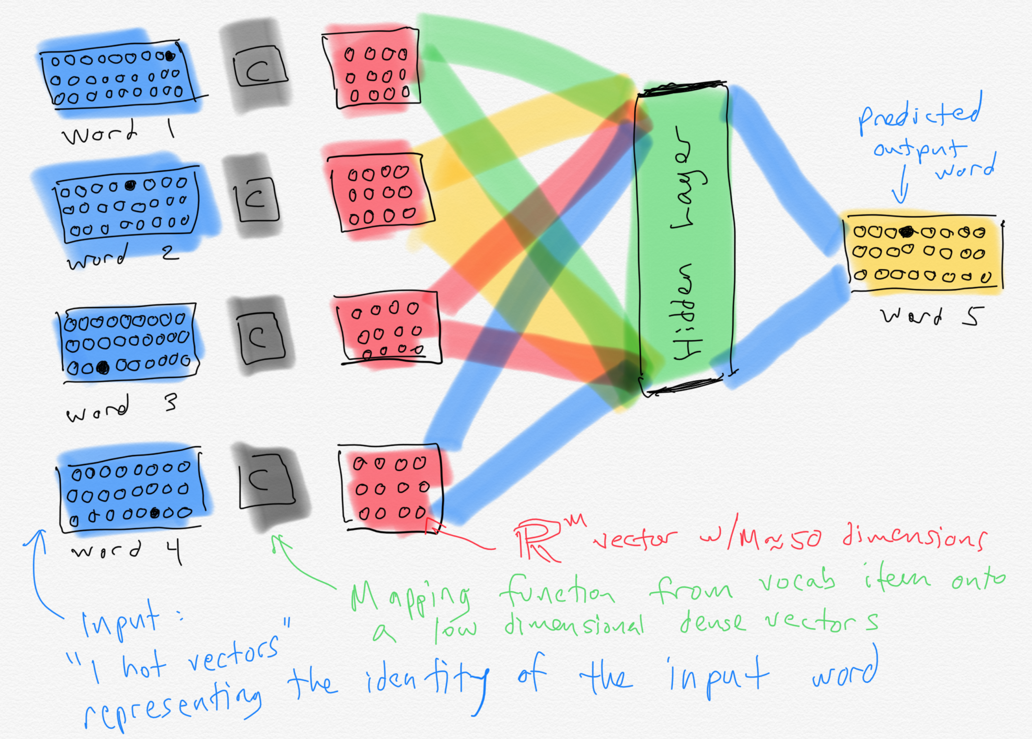

Slide 99
Word embeddings
When the ~50 dimensional vectors that result from training a neural LM are projected down to 2-dimensions, we see a lot of words that are intuitively similar to each other are close together.
Notes:
A by-product of training neural network-based language models are dense word embeddings, similar to word2vec.

Slide 100
Current state of the art neural LMs
ELMo
GPT
BERT
GPT-2
Notes:
ELMo: Embeddings from Language Models
GPT: Improving Language Understanding by Generative PreTraining
BERT: Bidirectional Encoder Representations from Transformers.

Slide 101
How do we get dense vectors?
One recipe: train a classifier!
1. Treat the target word and a neighboring context word as positive examples.
2. Randomly sample other words in the lexicon to get negative samples.
3. Use logistic regression to train a classifier to distinguish those two cases.
4. Use the weights as the embeddings.

Slide 102
Word2Vec
Mikolov et al. 2013
Learn embeddings as part of the process of word prediction.
Train a classifier to predict neighboring words
Inspired by neural net language models.
In so doing, learn dense embeddings for the words in the training corpus.
Advantages:
Fast, easy to train (much faster than SVD)
Available online in the word2vec package Including sets of pretrained embeddings!

Slide 103
Word2Vec
Predict each neighboring word in a context window of 2C of surrounding words
So for C=2, we are given a word wt and we try to predict its 4 surrounding words
[wt-2, wt-1, wt+1, wt+2]
Uses "negative sampling" for training

Slide 104
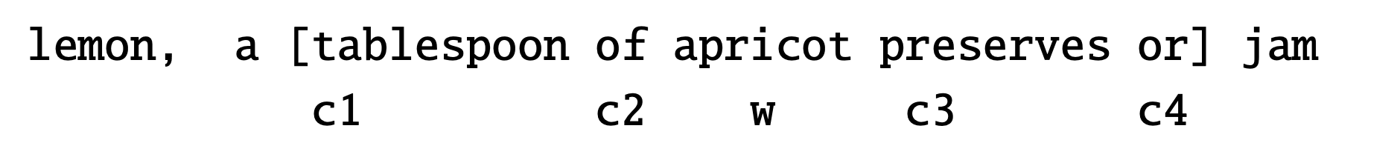

Negative sampling
We want predictions
of these words to be high
And these words to be low

Slide 105
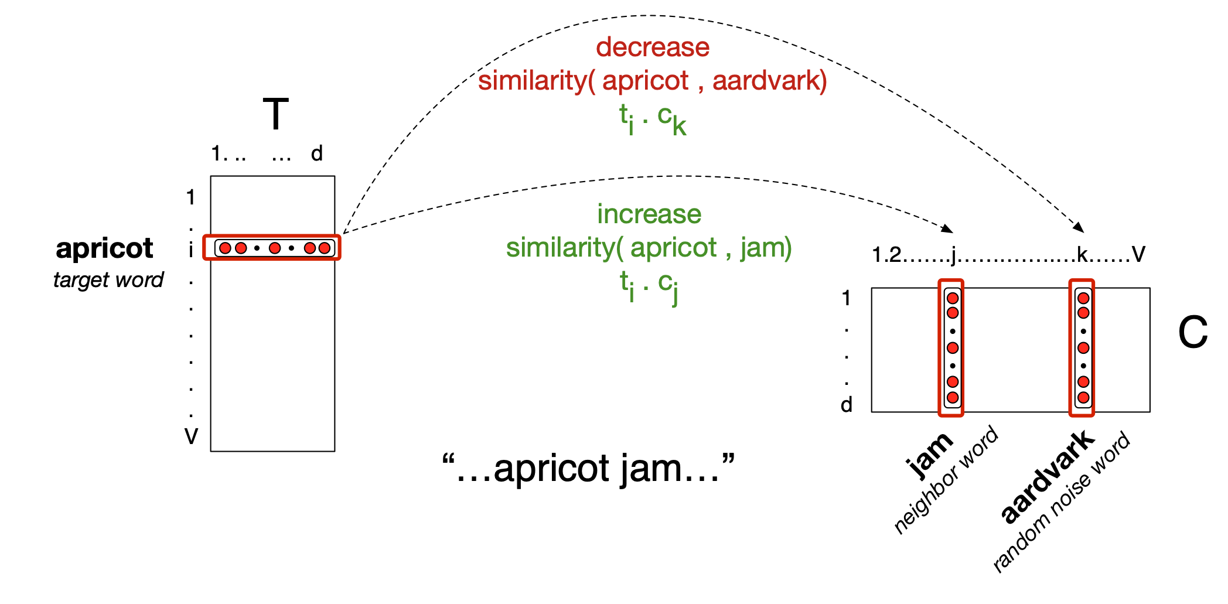
Neural Network

Slide 106
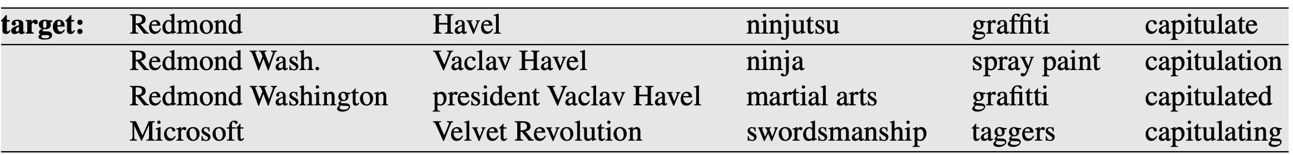
Properties of Embeddings
Nearest Neighbors are surprisingly good

Slide 107
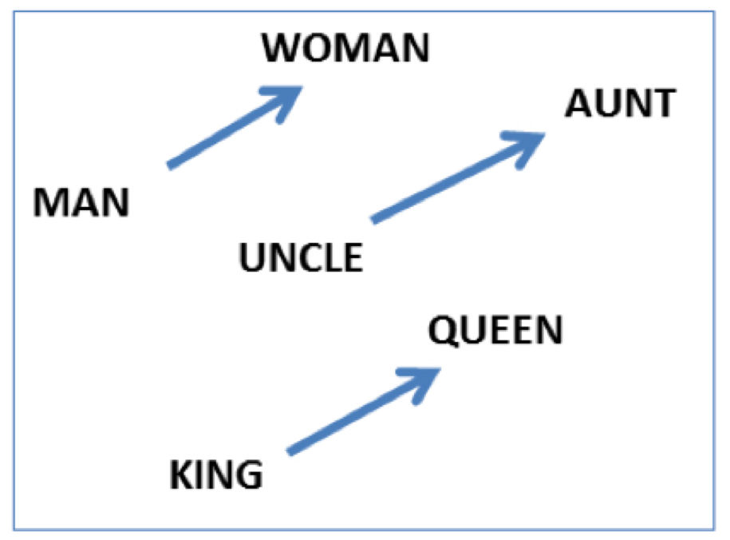
Embeddings capture relational meanings
.vector('king') - vector('man') + vector('queen') ≅ vector('woman')

Slide 108
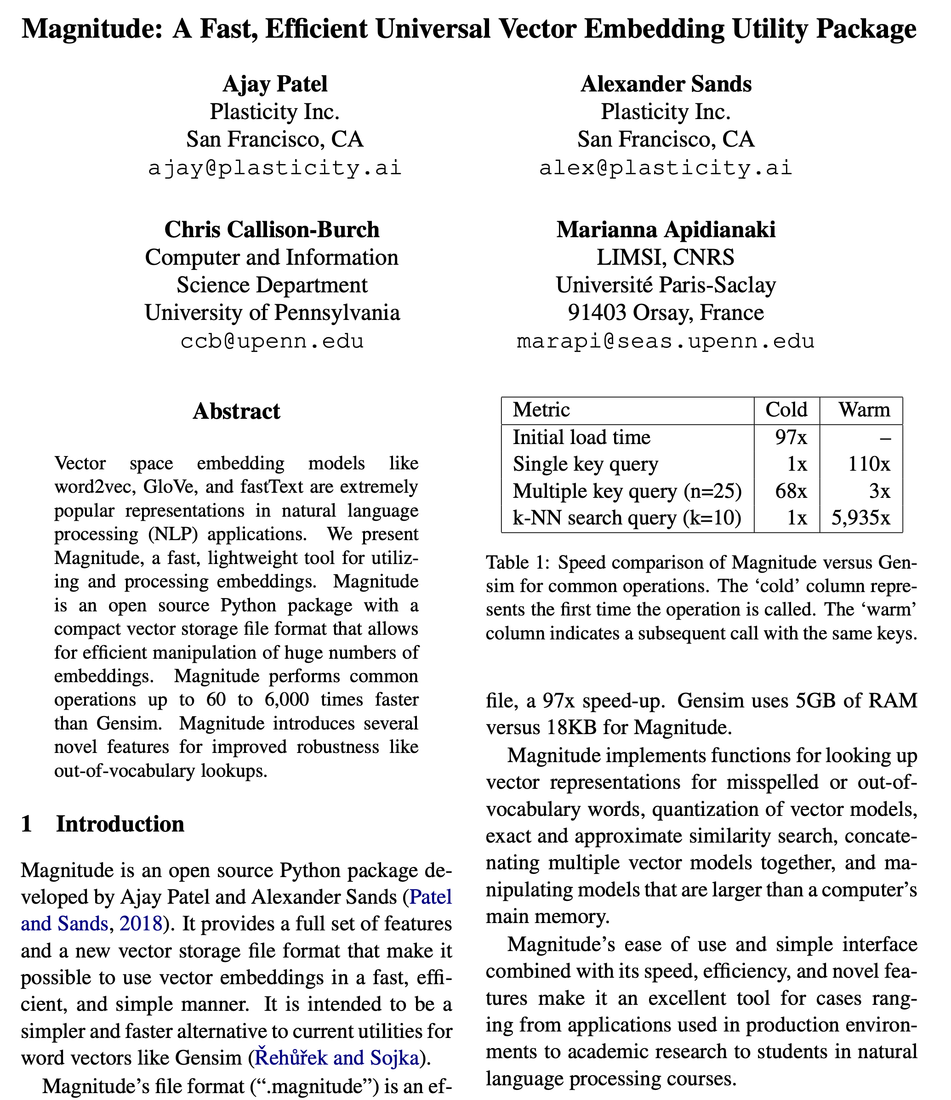

Slide 109
Demo of word vectors
# Install Magnitude
pip3 install pymagnitude
# Download Google’s word2vec vectors
wget http://magnitude.plasticity.ai/word2vec+approx/GoogleNews-vectors-negative300.magnitude
# Warning it’s 11GB large
# Start Python, and try the commands
# on the next slide
python3

Slide 110
Demo of word vectors
from pymagnitude import *
vectors = Magnitude("GoogleNews-vectors-negative300.magnitude")
queen = vectors.query('queen')
king = vectors.query("king")
vectors.similarity(king, queen)
# 0.6510958
vectors.most_similar_approx(king, topn=5)
#[('king', 1.0), ('kings', 0.72), ('prince', 0.62), ('sultan', 0.59), ('ruler', 0.58)]

Slide 111
Many possible models
Matrix type
Term-document
Term-context
Pattern-pair
Reweighting
length norm.
TF-IDF
PPMI
probabilities
Comparisons
cosine
Manhattan
Jaccard
KL divergence
JS distance
DICE
Dim. Reduction
word2vec
GloVe
PCA
LDA
LSA
How many dimensions?
What modifications should we make to the input?
Notes:
Modifications: tokenization/normalization, annotation/tagger, parsing, cluster text by author/time/etc.

Slide 112
Word Embeddings
Jurafsky and Martin Chapter 6

Slide 113
Sparse vectors
Documents created by term-by-document or term-context matrices are
long (length |V|= 20,000 to 50,000)
sparse (most elements are zero)

Slide 114
Alternative: dense vectors
vectors which are
short (length 50-1000)
dense (most elements are non-zero)

Slide 115
Sparse versus dense vectors
Why dense vectors?
Short vectors may be easier to use as features in machine learning (fewer weights to tune)
Dense vectors may generalize better than storing explicit counts
They may do better at capturing synonymy:
car and automobile are synonyms; but are distinct dimensions in sparse vectors
a word with car as a neighbor and a word with automobile as a neighbor should be similar, but aren't
In practice, they work better

Slide 116

Dense embeddings you can download!
Word2vec (Mikolov et al.)
https://code.google.com/archive/p/word2vec/
Fasttext http://www.fasttext.cc/
Glove (Pennington, Socher, Manning)
http://nlp.stanford.edu/projects/glove/
Magnitude (Patel and Sands)
https://github.com/plasticityai/magnitude

Slide 117
Word2vec
Popular embedding method
Very fast to train
Code available on the web
Idea: predict rather than count

Slide 118
Word2vec
Instead of counting how often each word w occurs near "apricot"
Train a classifier on a binary prediction task:
Is w likely to show up near "apricot"?
We don’t actually care about this task
But we'll take the learned classifier weights as the word embeddings
Notes:
The intuition of word2vec is that instead of counting how often each word w oc- curs near, say, apricot, we’ll instead train a classifier on a binary prediction task: “Is word w likely to show up near apricot?” We don’t actually care about this prediction task; instead we’ll take the learned classifier weights as the word embeddings.

Slide 119
Brilliant insight
Use running text as implicitly supervised training data!
A word s near apricot
Acts as gold ‘correct answer’ to the question
“Is word w likely to show up near apricot?”
No need for hand-labeled supervision
The idea comes from neural language modeling (Bengio et al. 2003))
Notes:
This idea was first proposed in the task of neural language modeling, when Bengio et al. (2003) and Collobert et al. (2011) showed that a neural language model (a neural network that learned to predict the next word from prior words) could just use the next word in running text as its supervision signal, and could be used to learn an embedding representation for each word as part of doing this prediction task.
We’ll see how to do neural networks in the next chapter, but word2vec is a much simpler model than the neural network language model, in two ways. First, word2vec simplifies the task (making it binary classification instead of word pre- diction). Second, word2vec simplifies the architecture (training a logistic regression classifier instead of a multi-layer neural network with hidden layers that demand more sophisticated training algorithms). The intuition of skip-gram is:

Slide 120
Word2Vec: Skip-Gram Task
Word2vec provides a variety of options. Let's do
"skip-gram with negative sampling" (SGNS)
Notes:
The revolutionary intuition here is that we can just use running text as implicitly supervised training data for such a classifier; a word s that occurs near the target word apricot acts as gold ‘correct answer’ to the question “Is word w likely to show up near apricot?” This avoids the need for any sort of hand-labeled supervision signal.

Slide 121
Skip-gram algorithm
Treat the target word and a neighboring context word as positive examples.
Randomly sample other words in the lexicon to get negative samples
Use logistic regression to train a classifier to distinguish those two cases
Use the weights as the embeddings

Slide 122
Skip-Gram Training Data
Training sentence:
... lemon, a tablespoon of apricot jam a pinch ...
c1 c2 target c3 c4
Assume context words are those in +/- 2 word window

Slide 123
Skip-Gram Goal
Given a tuple (t,c) = target, context
(apricot, jam)
(apricot, aardvark)
Return probability that c is a real context word:
P(+|t,c)
P(−|t,c) = 1−P(+|t,c)
Notes:
T = target, c = context
Our goal is to train a classifier such that, given a tuple (t,c) of a target word t paired with a candidate context word c (for example (apricot, jam), or perhaps (apricot, aardvark) it will return the probability that c is a real context word (true for jam, false for aardvark): P(+|t , c)
The probability that word c is not a real context word for t is just 1 minus that. P(−|t,c) = 1−P(+|t,c)

Slide 124
How to compute p(+|t,c)?
Intuition:
Words are likely to appear near similar words
Model similarity with dot-product!
Similarity(t,c) $≈$t ∙ c
Problem:
Dot product is not a probability!
(Neither is cosine)
Notes:
T = target, c = context
How does the classifier compute the probability P? The intuition of the skip- gram model is to base this probability on similarity: a word is likely to occur near the target if its embedding is similar to the target embedding. How can we compute similarity between embeddings? Recall that two vectors are similar if they have a high dot product (cosine, the most popular similarity metric, is just a normalized dot product). In other words: Similarity(t,c)≈t·c
Of course, the dot product t · c is not a probability, it’s just a number ranging from −∞ to ∞.
(Cosine is the dot product, divided by the vetor lengths of v and w)

Slide 125
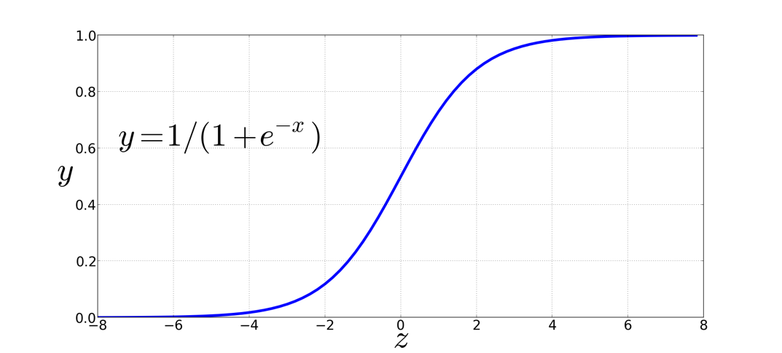
Turning dot product into a probability
The sigmoid lies between 0 and 1:
Notes:
The sigmoid function just returns a number between 0 and 1, so to make it a proba- bility we’ll need to make sure that the total probability of the two possible events (c being a context word, and c not being a context word) sum to 1.

Slide 126
Turning dot product into a probability
Notes:
The probability that word c is not a real context word for t is thus

Slide 127
Turning dot product into a probability
Notes:
The probability that word c is not a real context word for t is thus

Slide 128
For all the context words:
Assume all context words are independent
Notes:
That gives us the probability for one word, but we need to take account of the multiple context words in the window. Skip-gram makes the strong but very useful simplifying assumption that all context words are independent, allowing us to just multiply their probabilities.
In summary, skip-gram trains a probabilistic classifier that, given a test target word t and its context window of k words c1:k, assigns a probability based on how similar this context window is to the target word. The probability is based on applying the logistic (sigmoid) function to the dot product of the embeddings of the target word with each context word. We could thus compute this probability if only we had embeddings for each word target and context word in the vocabulary.

Slide 129
For all the context words:
Assume all context words are independent
Notes:
That gives us the probability for one word, but we need to take account of the multiple context words in the window. Skip-gram makes the strong but very useful simplifying assumption that all context words are independent, allowing us to just multiply their probabilities.
In summary, skip-gram trains a probabilistic classifier that, given a test target word t and its context window of k words c1:k, assigns a probability based on how similar this context window is to the target word. The probability is based on applying the logistic (sigmoid) function to the dot product of the embeddings of the target word with each context word. We could thus compute this probability if only we had embeddings for each word target and context word in the vocabulary.

Slide 130
Popping back up
Now we have a way of computing the probability of p(+|t,c), which is the probability that c is a real context word for t.
But, we need embeddings for t and c to do it.
Where do we get those embeddings?
Word2vec learns them automatically!
It starts with an initial set of embedding vectors and then iteratively shifts the embedding of each word w to be more like the embeddings of words that occur nearby in texts, and less like the embeddings of words that don’t occur nearby.

Slide 131
Skip-Gram Training Data
Training sentence:
... lemon, a tablespoon of apricot jam a pinch ...
c1 c2 t c3 c4
Training data: input/output pairs centering on apricot
Assume a +/- 2 word window
Notes:
OK, so now we have a way of computing the probability of p(+ | t, c), he probability that c is a real context word for t. BUT, we need embeddings for t and c to do it.

Slide 132
Skip-Gram Training
Training sentence:
... lemon, a tablespoon of apricot jam a pinch ...
c1 c2 t c3 c4
For each positive example, we'll create k negative examples.
Using noise words
Any random word that isn't t

Slide 133
How many noise words?
Training sentence:
... lemon, a tablespoon of apricot jam a pinch ...
c1 c2 t c3 c4
k=2
Notes:
Here k = 2, so we are picking twice as many negative training examples as positive ones.

Slide 134
Choosing noise words
Could pick w according to their unigram frequency P(w)
More common to chosen then according to p_{α}(w)
α= ¾ works well because it gives rare noise words slightly higher probability
To show this, imagine two events p(a)=.99 and p(b) = .01:
Notes:
The noise words are chosen according to their weighted unigram frequency pα (w), where α is a weight. If we were sampling according to unweighted fre- quency p(w), it would mean that with unigram probability p(“the”) we would choose the word the as a noise word, with unigram probability p(“aardvark”) we would
choose aardvark, and so on. But in practice it is common to set α = .75, i.e. use the weighting p^.75 (w)

Slide 135
Learning the classifier
Iterative process.
We’ll start with 0 or random weights
Then adjust the word weights to
make the positive pairs more likely
and the negative pairs less likely
over the entire training set:

Slide 136
Setup
Let's represent words as vectors of some length (say 300), randomly initialized.
So we start with 300 * V random parameters
Over the entire training set, we’d like to adjust those word vectors such that we
Maximize the similarity of the target word, context word pairs (t,c) drawn from the positive data
Minimize the similarity of the (t,c) pairs drawn from the negative data.

Slide 137
Objective Criteria
We want to maximize…
Maximize the + label for the pairs from the positive training data, and the – label for the pairs sample from the negative data.
Notes:
Given the set of positive and negative training instances, and an initial set of embeddings, the goal of the learning algorithm is to adjust those embeddings such that we
• Maximize the similarity of the target word, context word pairs (t,c) drawn from the positive examples
• Minimize the similarity of the (t,c) pairs drawn from the negative examples.

Slide 138
Focusing on one target word t:
Notes:
we want to maximize the dot product of the word with the actual context words, and minimize the dot products of the word with the k negative sampled non-neighbor words.
We can then use stochastic gradient descent to train to this objective, iteratively modifying the parameters (the embeddings for each target word t and each context word or noise word c in the vocabulary) to maximize the objective.

Slide 139
Notes:
The skip-gram model tries to shift embeddings so the target embedding (here for apricot) are closer to (have a higher dot product with) context embeddings for nearby words (here jam) and further from (have a lower dot product with) context embeddings for words that don’t occur nearby (here aardvark).
Note that the skip-gram model thus actually learns two separate embeddings for each word w: the target embedding t and the context embedding c. These embeddings are stored in two matrices, the target matrix T and the context matrix C. So each row i of the target matrix T is the 1 × d vector embedding ti for word i in the vocabulary V , and each column i of the context matrix C is a d × 1 vector embedding ci for word i in V . This figure shows an intuition of the learning task for the embeddings encoded in these two matrices.

Slide 140
Train using gradient descent
Actually learns two separate embedding matrices W and C
Can use W and throw away C, or merge them somehow
Notes:
The learning algorithm starts with randomly initialized W and C matrices, and then walks through the training corpus using gradient descent to move W and C so as to maximize the objective in Eq. 6.34. Thus the matrices W and C function as the parameters θ that logistic regression is tuning.
Once the embeddings are learned, we’ll have two embeddings for each word wi: ti and ci . We can choose to throw away the C matrix and just keep W , in which case each word i will be represented by the vector ti.
Alternatively we can add the two embeddings together, using the summed em- bedding ti + ci as the new d-dimensional embedding, or we can concatenate them into an embedding of dimensionality 2d.

Slide 141
Summary: How to learn word2vec (skip-gram) embeddings
Start with V random 300-dimensional vectors as initial embeddings
Use logistic regression
Take a corpus and take pairs of words that co-occur as positive examples
Take pairs of words that don't co-occur as negative examples
Train the classifier to distinguish these by slowly adjusting all the embeddings to improve the classifier performance
Throw away the classifier code and keep the embeddings.
Notes:
Logistic regression is covered in Chapter 5 of the textbook

Slide 142
Evaluating embeddings
Compare to human scores on word similarity-type tasks:
WordSim-353 (Finkelstein et al., 2002)
SimLex-999 (Hill et al., 2015)
Stanford Contextual Word Similarity (SCWS) dataset (Huang et al., 2012)
TOEFL dataset: “levied” is closest in meaning to: (a) imposed, (b) believed, (c) requested, (d) correlated

Slide 143
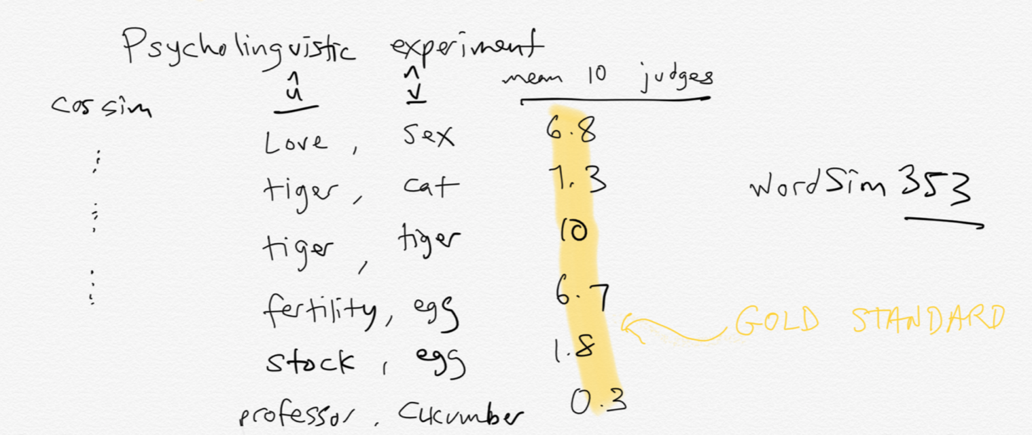
Intrinsic evaluation

Slide 144
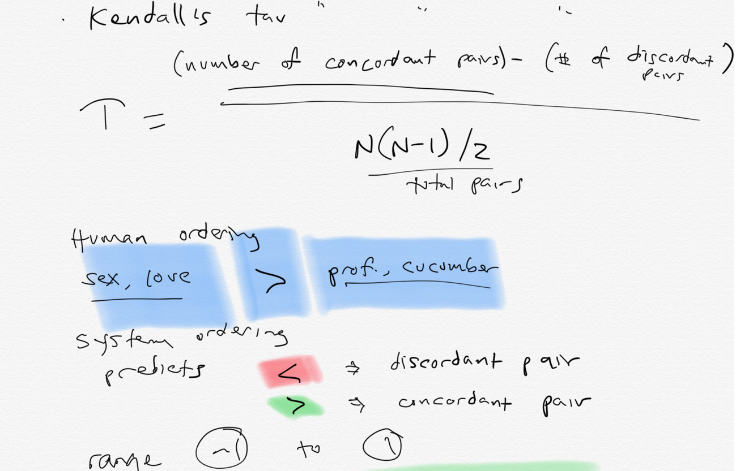
Compute correlation

Slide 145
Properties of embeddings
Similarity depends on window size C
C = ±2 The nearest words to Hogwarts:
Sunnydale
Evernight
C = ±5 The nearest words to Hogwarts:
Dumbledore
Malfoy
halfblood

Slide 146
How does context window change word emeddings?

Slide 147
Solving Analogy Problems

Slide 148
Solving analogies with embeddings
In a word-analogy task we are given two pairs of words that share a relation (e.g. “man:woman”, “king:queen”).
The identity of the fourth word (“queen”) is hidden, and we need to infer it based on the other three by answering
“man is to woman as king is to — ?”
More generally, we will say a:a∗ as b:b∗.
How can we solve these with word vectors?

Slide 149
Vector Arithmetic
a:a∗ as b:b∗. b∗ is a hidden vector.
b∗ should be similar to the vector b − a + a∗
vector(‘king’) - vector(‘man’) + vector(‘woman’) $≈$vector(‘queen’)
king
queen
man
woman
Notes:
Analogy Another semantic property of embeddings is their ability to capture re- lational meanings. Mikolov et al. (2013b) and Levy and Goldberg (2014b) show that the offsets between vector embeddings can capture some analogical relations between words. For example, the result of the expression vector(‘king’) - vec- tor(‘man’) + vector(‘woman’) is a vector close to vector(‘queen’); the left panel in Fig. 6.14 visualizes this, again projected down into 2 dimensions. Similarly, they found that the expression vector(‘Paris’) - vector(‘France’) + vector(‘Italy’) results in a vector that is very close to vector(‘Rome’).

Slide 150
Vector Arithmetic
a:a∗ as b:b∗. b∗ is a hidden vector.
b∗ should be similar to the vector b − a + a∗
vector(‘king’) - vector(‘man’) + vector(‘woman’) $≈$vector(‘queen’)
king
queen
man
woman
Notes:
Analogy Another semantic property of embeddings is their ability to capture re- lational meanings. Mikolov et al. (2013b) and Levy and Goldberg (2014b) show that the offsets between vector embeddings can capture some analogical relations between words. For example, the result of the expression vector(‘king’) - vec- tor(‘man’) + vector(‘woman’) is a vector close to vector(‘queen’); the left panel in Fig. 6.14 visualizes this, again projected down into 2 dimensions. Similarly, they found that the expression vector(‘Paris’) - vector(‘France’) + vector(‘Italy’) results in a vector that is very close to vector(‘Rome’).

Slide 151
Analogy: Embeddings capture relational meaning!
a:a∗ as b:b∗. b∗ is a hidden vector.
b∗ should be similar to the vector b − a + a∗
vector(‘king’) - vector(‘man’) + vector(‘woman’) $≈$vector(‘queen’)
king
-man
+woman
queen
man
woman
Notes:
Analogy Another semantic property of embeddings is their ability to capture re- lational meanings. Mikolov et al. (2013b) and Levy and Goldberg (2014b) show that the offsets between vector embeddings can capture some analogical relations between words. For example, the result of the expression vector(‘king’) - vec- tor(‘man’) + vector(‘woman’) is a vector close to vector(‘queen’); the left panel in Fig. 6.14 visualizes this, again projected down into 2 dimensions. Similarly, they found that the expression vector(‘Paris’) - vector(‘France’) + vector(‘Italy’) results in a vector that is very close to vector(‘Rome’).

Slide 152
Vector Arithmetic
a:a∗ as b:b∗. b∗ is a hidden vector.
b∗ should be similar to the vector b − a + a∗
vector(‘king’) - vector(‘man’) + vector(‘woman’) $≈$vector(‘queen’)
king
-man
+woman
queen
man
woman
The analogy question can be solved by optimizing:
Notes:
Analogy Another semantic property of embeddings is their ability to capture re- lational meanings. Mikolov et al. (2013b) and Levy and Goldberg (2014b) show that the offsets between vector embeddings can capture some analogical relations between words. For example, the result of the expression vector(‘king’) - vec- tor(‘man’) + vector(‘woman’) is a vector close to vector(‘queen’); the left panel in Fig. 6.14 visualizes this, again projected down into 2 dimensions. Similarly, they found that the expression vector(‘Paris’) - vector(‘France’) + vector(‘Italy’) results in a vector that is very close to vector(‘Rome’).

Slide 153
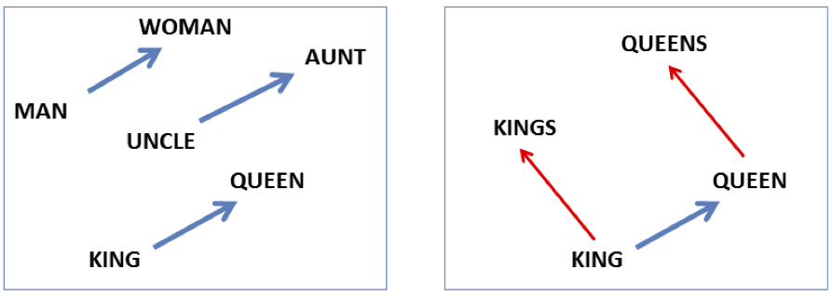
Analogy: Embeddings capture relational meaning!
vector(‘king’) - vector(‘man’) + vector(‘woman’) $≈$vector(‘queen’)
vector(‘Paris’) - vector(‘France’) + vector(‘Italy’) $≈$ vector(‘Rome’)
Notes:
Analogy Another semantic property of embeddings is their ability to capture relational meanings. Mikolov et al. (2013b) and Levy and Goldberg (2014b) show that the offsets between vector embeddings can capture some analogical relations between words. For example, the result of the expression vector(‘king’) - vec- tor(‘man’) + vector(‘woman’) is a vector close to vector(‘queen’); the left panel in Fig. 6.14 visualizes this, again projected down into 2 dimensions. Similarly, they found that the expression vector(‘Paris’) - vector(‘France’) + vector(‘Italy’) results in a vector that is very close to vector(‘Rome’).

Slide 154
Vector Arithmetic
If all word-vectors are normalized to unit length then
is equivalent to
Notes:
This means that solving analogy questions with vector arithmetic is mathematically equivalent to seeking a word (b∗) which is similar to b and a∗ but is different from a. Relational similarity is thus expressed as a sum of attributional similarities.
attributional similarities between vocabulary items means that words that appear in similar contexts will be close to each other in the projected space

Slide 155
Vector Arithmetic
Alternatively, we can require that the direction of the transformation be maintained.
This basically means that b∗ − b shares the same direction with a∗ − a, ignoring the distances
Notes:
Levy and Goldberg refer to this method as PAIRDIRECTION.
In this study, we show that similarly to the neural embedding space, the explicit vector space also encodes a vast amount of relational similar- ity which can be recovered in a similar fashion, suggesting the explicit vector space representation as a competitive baseline for further work on neu- ral embeddings

Slide 156
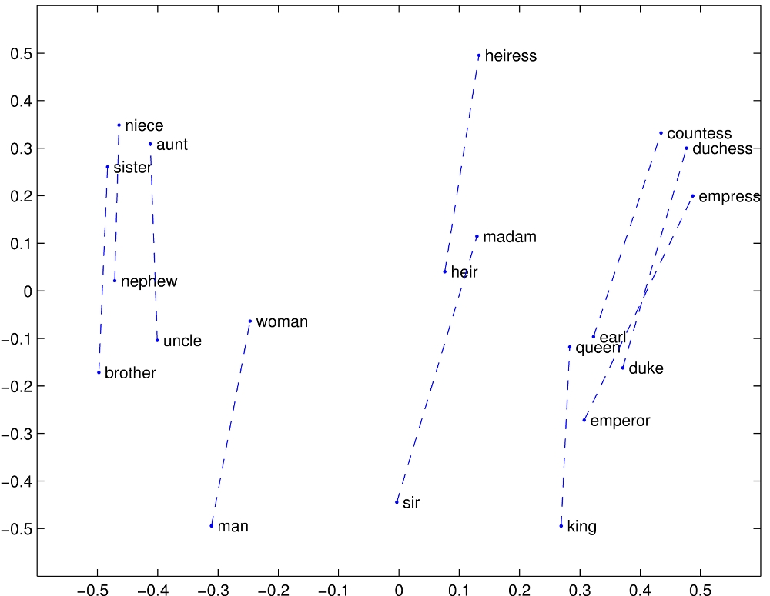
Notes:
Relational properties of the vector space, shown by projecting vectors onto two dimensions. (a) ’king’ - ’man’ + ’woman’ is close to ’queen’

Slide 157
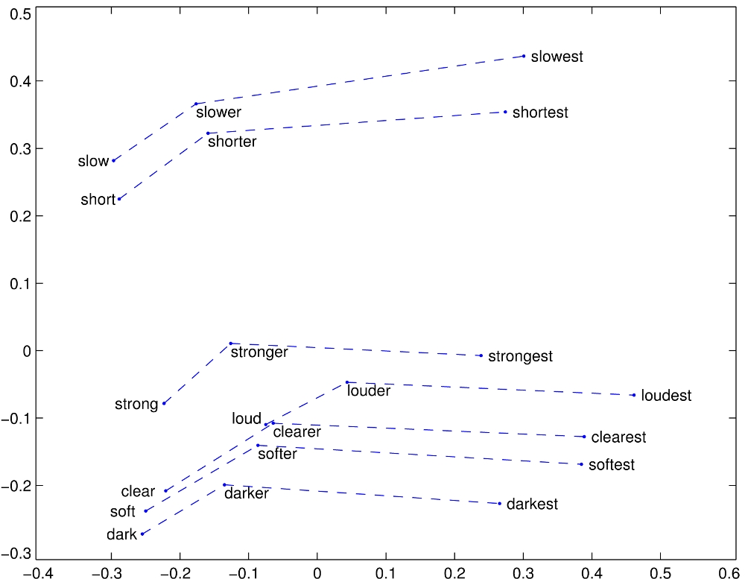
Notes:
Relational properties of the vector space,
offsets seem to capture comparative and superlative morphology (Pennington et al., 2014).

Slide 158
Representing Phrases with vectors
Mikolov et al constructed representations for phrases as well as for individual words.
To learn vector representations for phrases, they first find words that appear frequently together but infrequently in other contexts, and represent these n-grams as single tokens.
For example, “New York Times” and “Toronoto Maple Leafs” are replaced by New_York_Times and Toronoto_Maple_Leafs, but a bigram like “this is” remains unchanged.
Notes:
The δ is used as a discounting coefficient and prevents too many phrases consisting of very infre- quent words to be formed. The bigrams with score above the chosen threshold are then used as phrases. Typically, we run 2-4 passes over the training data with decreasing threshold value, allow- ing longer phrases that consists of several words to be formed.

Slide 159
Analogical reasoning task for phrases

Slide 160
Vector compositionality
Mikolov et al experiment with using element-wise addition to compose vectors
Notes:
CCB – try some out in Magnitude

Slide 161
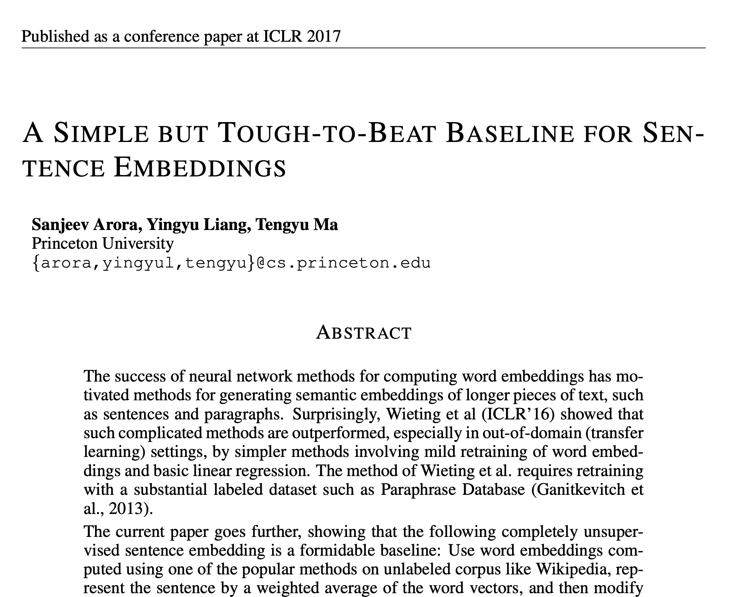

Slide 162
Word Embeddings for Sociology

Slide 163

Embeddings can help study word history!
Train embeddings on old books to study changes in word meaning!!
Dan Jurafsky
Will Hamilton
Notes:
Embeddings and Historical Semantics: Embeddings can also be a useful tool for studying how meaning changes over time, by computing multiple embedding spaces, each from texts written in a particular time period. For example Fig. 6.15 shows a visualization of changes in meaning in English words over the last two centuries, computed by building separate embedding spaces for each decade from historical corpora like Google N-grams (Lin et al., 2012) and the Corpus of Histori- cal American English (Davies, 2012).

Slide 164



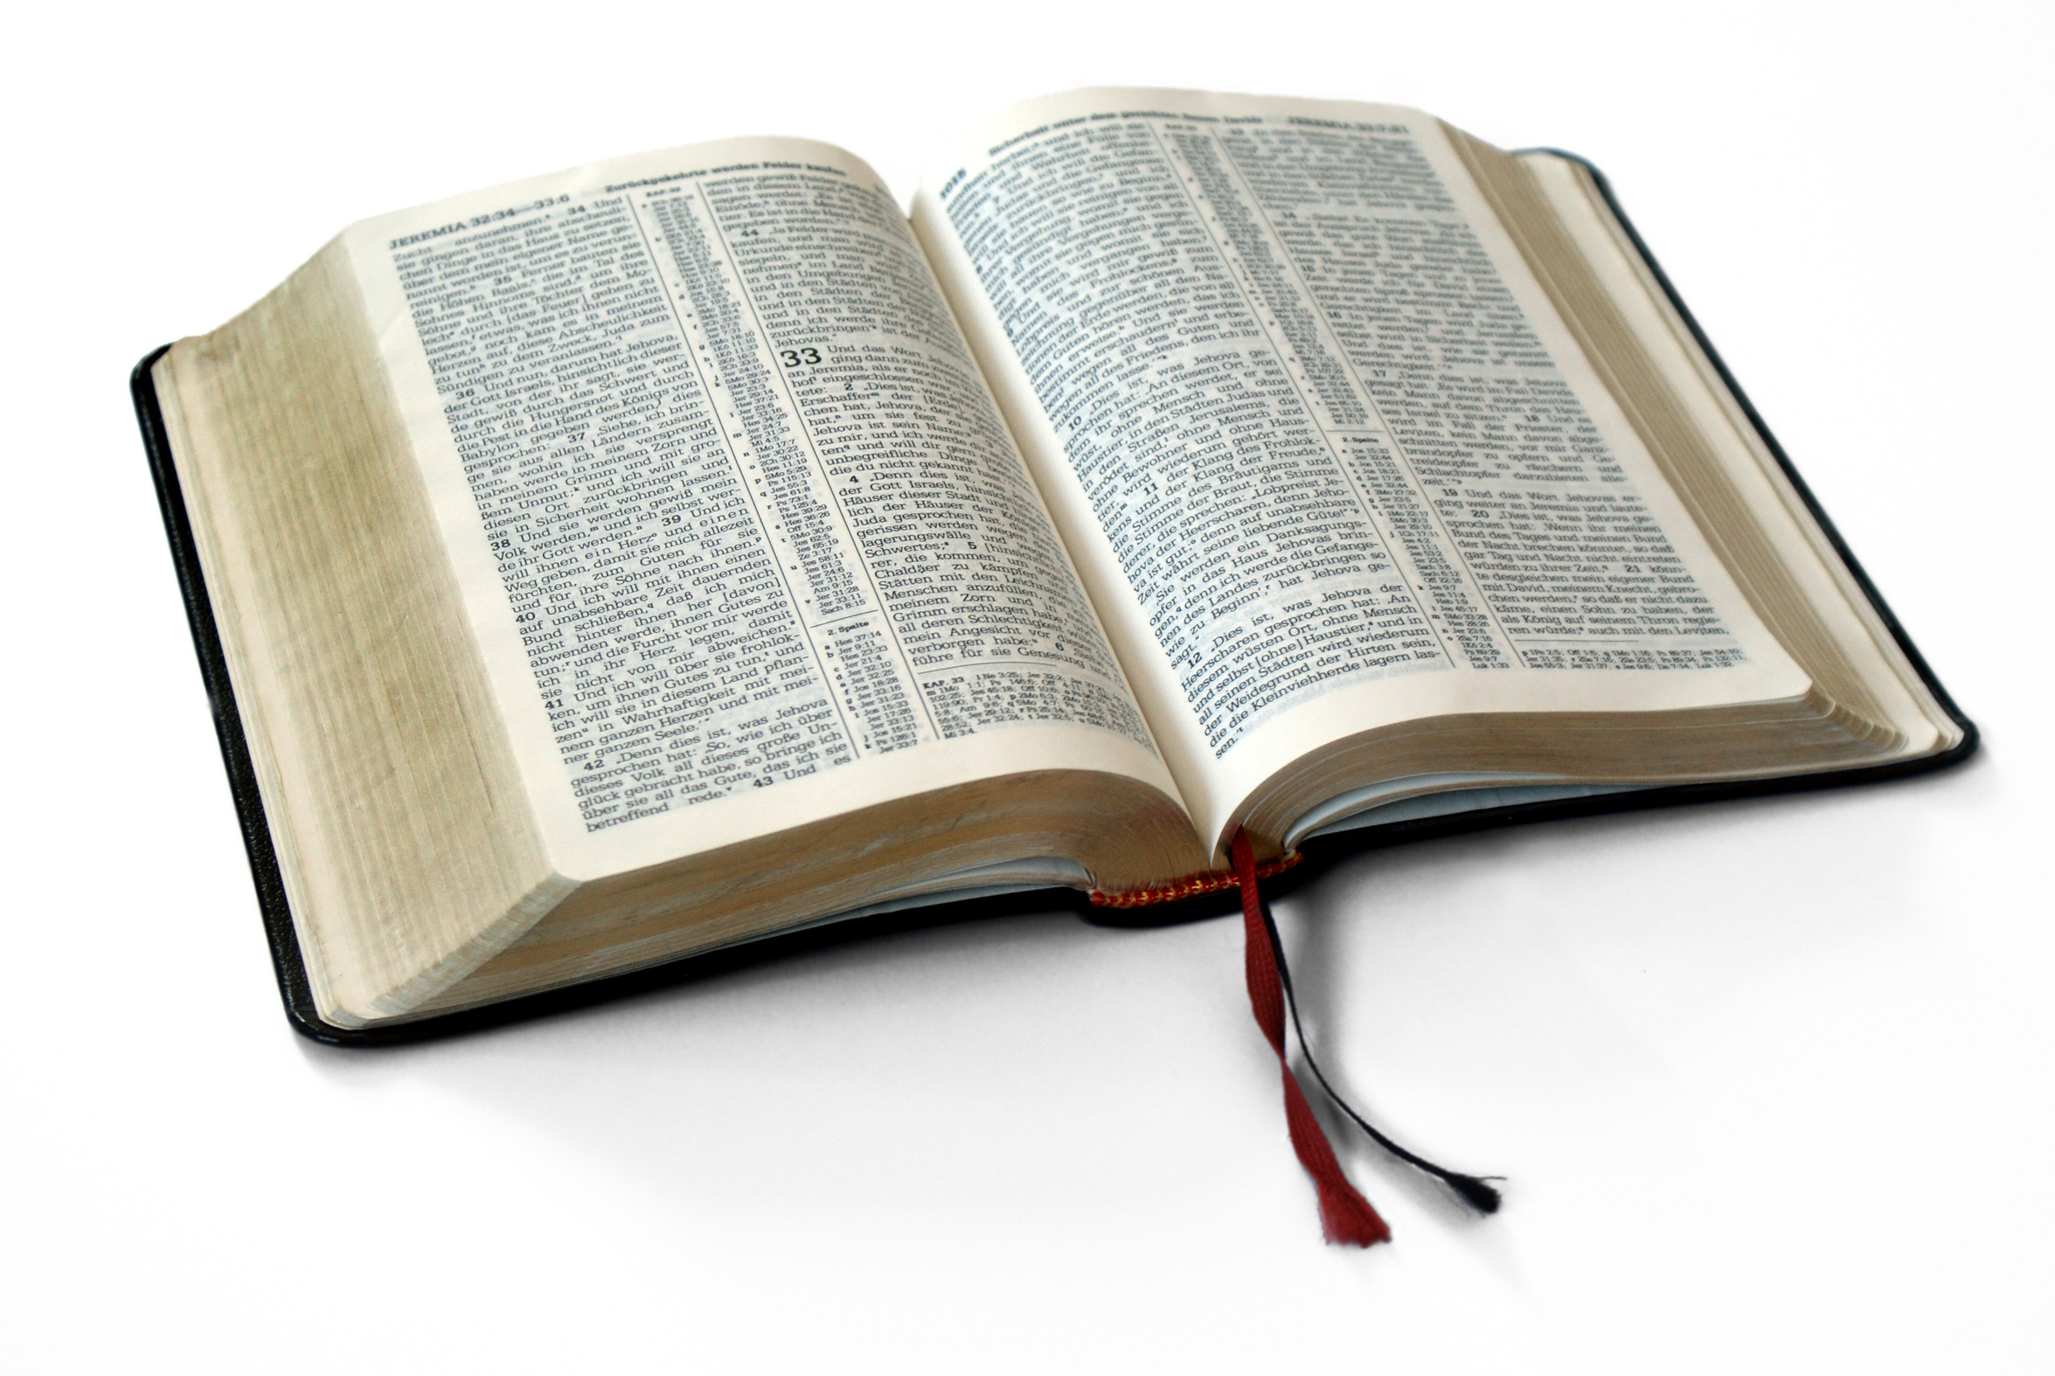
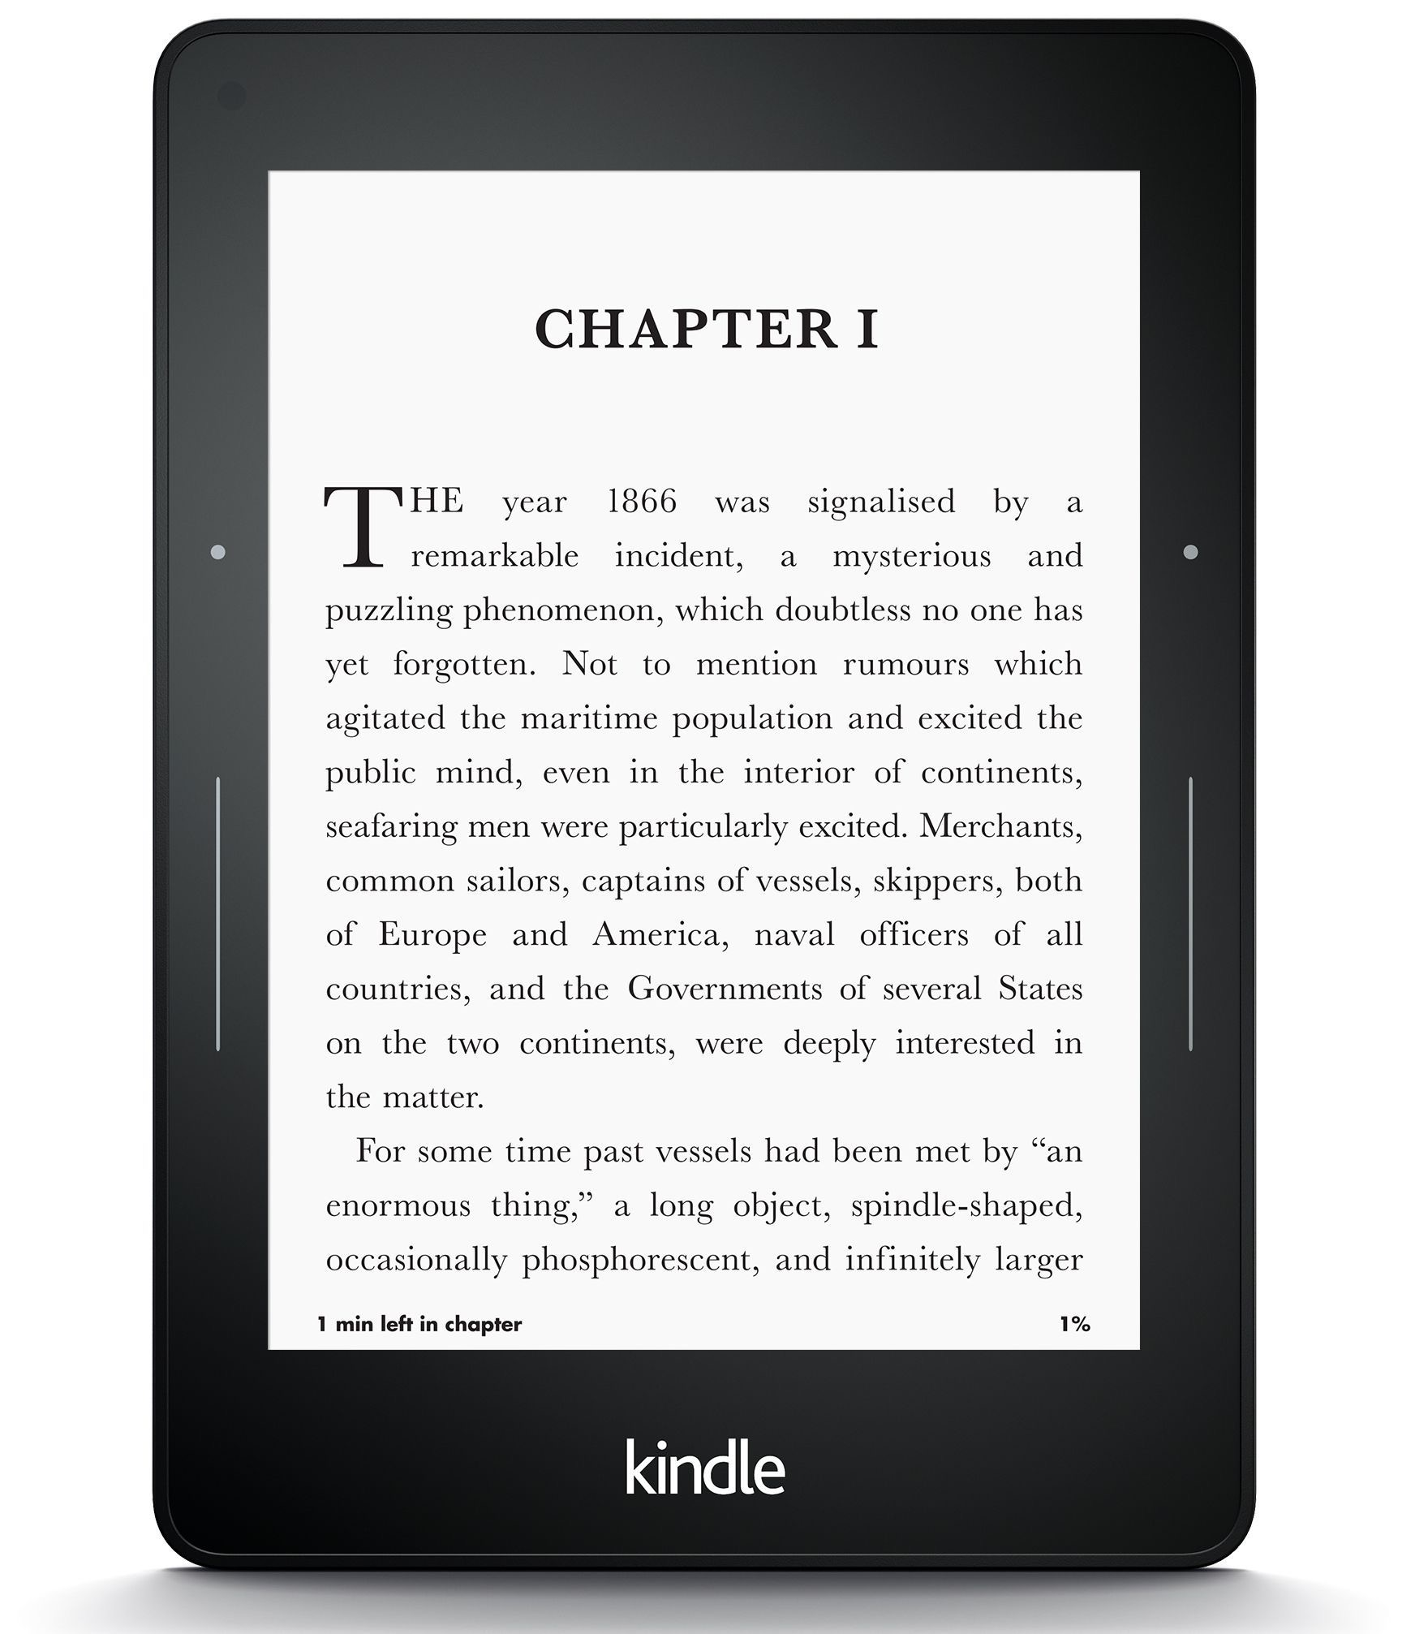
Diachronic word embeddings for studying language change!
Word vectors for 1920
Word vectors 1990
“dog” 1990 word vector
“dog” 1920 word vector
vs.
1900
1950
2000
￼
￼
Notes:
di·a·chron·ic | ˌdīəˈkränik |
adjective
concerned with the way in which something, especially language, has developed and evolved through time. linguistic change is the diachronic aspect of linguistic variation.

Slide 165
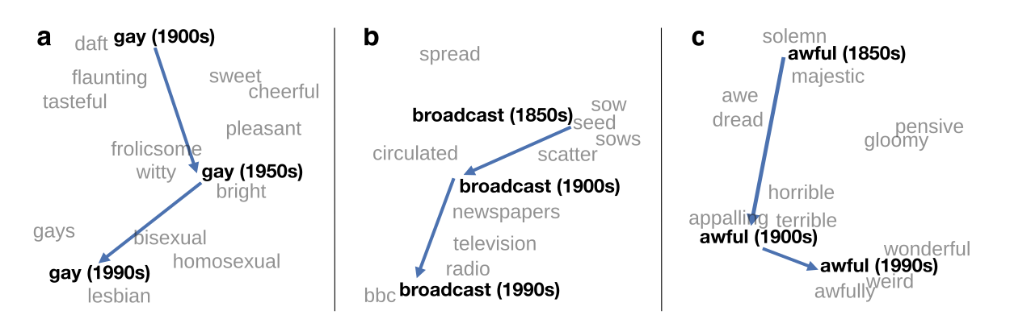
Visualizing changes
Project 300 dimensions down into 2
~30 million books, 1850-1990, Google Books data
Notes:
visualization of the semantic change of 3 words in English using
Figure 5à: Two-dimensional visualization of semantic change in English using SGNS word2vec vectors. The modern sense of each word, and the grey context words, are com-
vectors see Section 5à8 for the visualization algorithm à A, The word gay shifted puted from the most recent (modern) time-point embedding space. Earlier points are com-
from meaning ÒcheerfulÓ or ÒfrolicsomeÓ to referring to homosexualityà A, In the early puted from earlier historical embedding spaces. The visualizations show the changes in the
2àth century broadcast referred to Òcasting out seedsÓà with the rise of television and word gay from meanings related to “cheerful” or “frolicsome” to referring to homosexuality,
radio its meaning shifted to Òtransmitting signalsÓà C, Awful underwent a process of the development of the modern “transmission” sense of broadcast from its original sense of
pejoration, as it shifted from meaning Òfull of aweÓ to meaning Òterrible or appallingÓ
sowing seeds, and the pejoration of the word awful as it shifted from meaning “full of awe” t2om2eàaning “terrible or appalling”

Slide 166
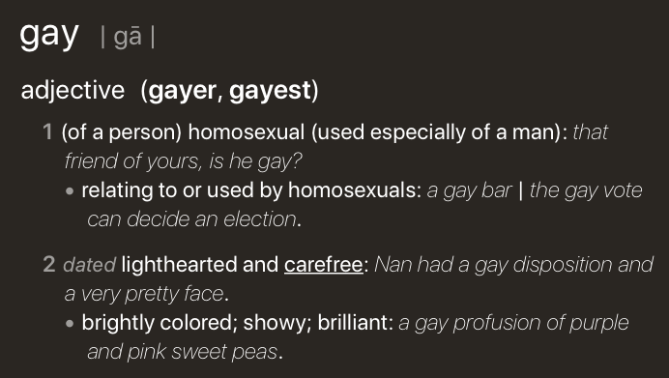
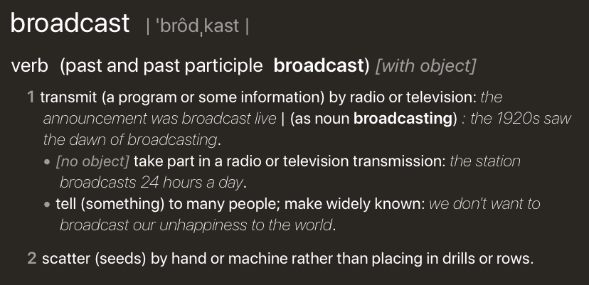
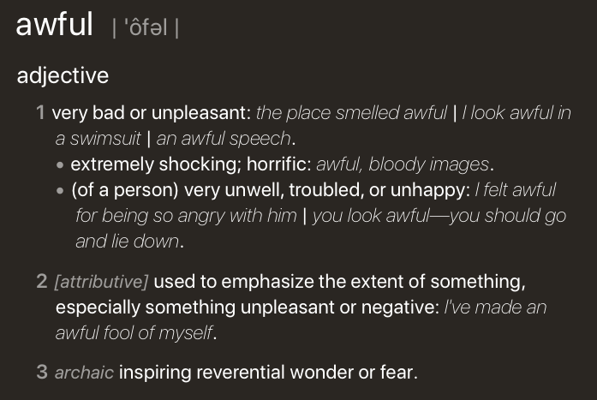
Visualizing changes
Project 300 dimensions down into 2
~30 million books, 1850-1990, Google Books data
Notes:
visualization of the semantic change of 3 words in English using
Figure 5à: Two-dimensional visualization of semantic change in English using SGNS word2vec vectors. The modern sense of each word, and the grey context words, are com-
vectors see Section 5à8 for the visualization algorithm à A, The word gay shifted puted from the most recent (modern) time-point embedding space. Earlier points are com-
from meaning ÒcheerfulÓ or ÒfrolicsomeÓ to referring to homosexualityà A, In the early puted from earlier historical embedding spaces. The visualizations show the changes in the
2àth century broadcast referred to Òcasting out seedsÓà with the rise of television and word gay from meanings related to “cheerful” or “frolicsome” to referring to homosexuality,
radio its meaning shifted to Òtransmitting signalsÓà C, Awful underwent a process of the development of the modern “transmission” sense of broadcast from its original sense of
pejoration, as it shifted from meaning Òfull of aweÓ to meaning Òterrible or appallingÓ
sowing seeds, and the pejoration of the word awful as it shifted from meaning “full of awe” t2om2eàaning “terrible or appalling”

Slide 167
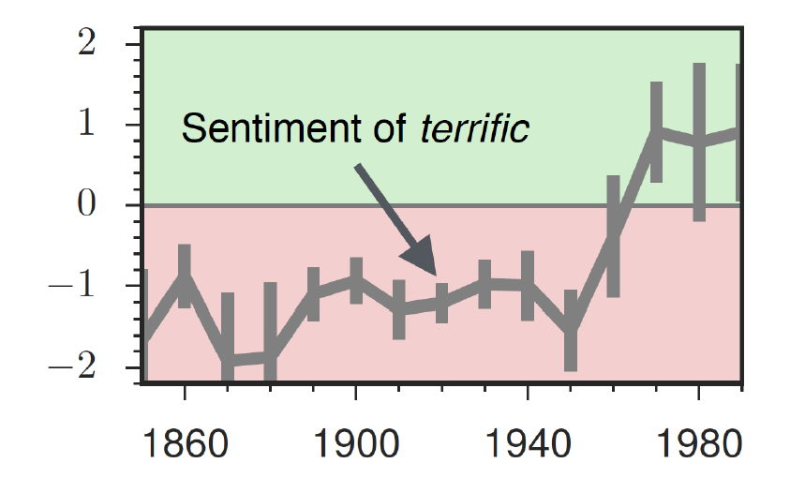
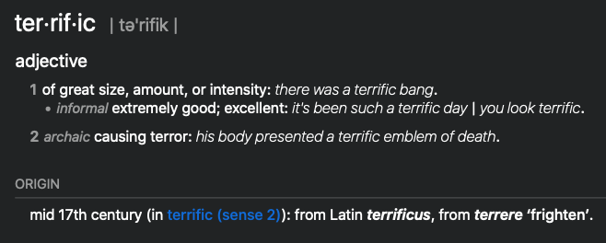
The evolution of sentiment words

Slide 168
Embeddings and bias
Notes:
In addition to their ability to learn word meaning from text, embeddings, alas, also
indicating surprise disbelief à
reproduce the implicit biases and stereotypes that were latent in the text. Recall that
embeddings model analogical relations; ‘queen’ as the closest word to ’king’ - ’man’
+ ’woman’ implies the analogy man:woman::king:queen. But embedding analogies 5à2à2 Computational linguistic studies
also exhibit gender stereotypes.

Slide 169
Embeddings reflect cultural bias
Ask “Paris : France :: Tokyo : x”
x = Japan
Ask “father : doctor :: mother : x”
x = nurse
Ask “man : computer programmer :: woman : x”
x = homemaker
Bolukbasi, Tolga, Kai-Wei Chang, James Y. Zou, Venkatesh Saligrama, and Adam T. Kalai. "Man is to computer programmer as woman is to homemaker? debiasing word embeddings." In Advances in Neural Information Processing Systems, pp. 4349-4357. 2016.
Notes:
For example Bolukbasi et al. (2016) find that the closest occupation to ‘man’ - ‘computer programmer’ + ‘woman’ in word2vec em-
There are also a number of recent works analyzing semantic change using computational
beddings trained on news text is ‘homemaker’, and that the embeddings similarly
methodsà 2àà use latent semantic analysis to analyze how word meanings broaden
suggest the analogy ‘father’ is to ‘doctor’ as ‘mother’ is to ‘nurse’. Algorithms that
and narrow over timeà 3 use raw co-occurrence vectors to perform a number of
used embeddings as part of an algorithm to search for potential programmers or
historical case-studies on semantic change, and 252 perform a similar set of small-
doctors might thus incorrectly downweight documents with women’s names.

Slide 170
Measuring cultural bias
Implicit Association test (Greenwald et al 1998): How associated are
concepts (flowers, insects) & attributes (pleasantness, unpleasantness)?
Studied by measuring timing latencies for categorization.
Psychological findings on US participants:
African-American names are associated with unpleasant words (more than European-American names)
Male names associated more with math, female names with arts
Old people's names with unpleasant words, young people with pleasant words.
Notes:
Roughly speaking, if humans associate ‘flowers’ with ’pleasantness’ and ‘insects’ with ‘unpleasant- ness’, when they are instructed to push a red button for ‘flowers’ (daisy, iris, lilac) and ’pleasant words’ (love, laughter, pleasure) and a green button for ‘insects’ (flea, spider, mosquito) and ‘unpleasant words’ (abuse, hatred, ugly) they are faster than in an incongruous condition where they push a red button for ‘flowers’ and ‘unpleasant words’ and a green button for ‘insects’ and ‘pleasant words
Embeddings also encode the implicit associations that are a property of human
scale case-studies using temporal topic modelsà 8à construct point-wise mutual
reasoning. The Implicit Association Test (Greenwald et al., 1998) measures peo- information-based embeddings and found that semantic changes uncovered by their
ple’s associations between concepts (like ’flowers’ or ’insects’) and attributes (like
method had reasonable agreement with human judgmentsà 29 and 9 use ÒneuralÓ
‘pleasantness’ and ‘unpleasantness’) by measuring differences in the latency with
word-embedding methods to detect linguistic change pointsà Finally, 25à analyze
which they label words in the various categories.6 Using such methods, people in the United States have been shown to associate African-American names with
historical co-occurrences to test whether synonyms tend to change in similar waysà
unpleasant words (more than European-American names), male names more with mathematics and female names with the arts, and old people’s names with unpleas- ant words (Greenwald et al. 1998, Nosek et al. 2002a, Nosek et al. 2002b). Caliskan et al. (2017) replicated all these findings of implicit associations using GloVe vec- tors and cosine similarity instead of human latencies. For example Afrian American names like ‘Leroy’ and ‘Shaniqua’ had a higher GloVe cosine with unpleasant words while European American names (‘Brad’, ‘Greg’, ‘Courtney’) had a higher cosine with pleasant words. Any embedding-aware algorithm that made use of word senti- ment could thus lead to bias against African Americans.

Slide 171
Embeddings reflect cultural bias
Caliskan et al. replication with embeddings:
African-American names (Leroy, Shaniqua) had a higher GloVe cosine with unpleasant words (abuse, stink, ugly)
European American names (Brad, Greg, Courtney) had a higher cosine with pleasant words (love, peace, miracle)
Embeddings reflect and replicate all sorts of pernicious biases.
Aylin Caliskan, Joanna J. Bruson and Arvind Narayanan. 2017. Semantics derived automatically from language corpora contain human-like biases. Science 356:6334, 183-186.
Notes:
Roughly speaking, if humans associate ‘flowers’ with ’pleasantness’ and ‘insects’ with ‘unpleasant- ness’, when they are instructed to push a red button for ‘flowers’ (daisy, iris, lilac) and ’pleasant words’ (love, laughter, pleasure) and a green button for ‘insects’ (flea, spider, mosquito) and ‘unpleasant words’ (abuse, hatred, ugly) they are faster than in an incongruous condition where they push a red button for ‘flowers’ and ‘unpleasant words’ and a green button for ‘insects’ and ‘pleasant words
Embeddings also encode the implicit associations that are a property of human
scale case-studies using temporal topic modelsà 8à construct point-wise mutual
reasoning. The Implicit Association Test (Greenwald et al., 1998) measures peo- information-based embeddings and found that semantic changes uncovered by their
ple’s associations between concepts (like ’flowers’ or ’insects’) and attributes (like
method had reasonable agreement with human judgmentsà 29 and 9 use ÒneuralÓ
‘pleasantness’ and ‘unpleasantness’) by measuring differences in the latency with
word-embedding methods to detect linguistic change pointsà Finally, 25à analyze
which they label words in the various categories.6 Using such methods, people in the United States have been shown to associate African-American names with
historical co-occurrences to test whether synonyms tend to change in similar waysà
unpleasant words (more than European-American names), male names more with mathematics and female names with the arts, and old people’s names with unpleas- ant words (Greenwald et al. 1998, Nosek et al. 2002a, Nosek et al. 2002b). Caliskan et al. (2017) replicated all these findings of implicit associations using GloVe vec- tors and cosine similarity instead of human latencies. For example Afrian American names like ‘Leroy’ and ‘Shaniqua’ had a higher GloVe cosine with unpleasant words while European American names (‘Brad’, ‘Greg’, ‘Courtney’) had a higher cosine with pleasant words. Any embedding-aware algorithm that made use of word senti- ment could thus lead to bias against African Americans.

Slide 172
Directions
Debiasing algorithms for embeddings
Use embeddings as a tool to study historical bias

Slide 173
Embeddings as a window onto history
Use the Hamilton historical embeddings
The cosine similarity of embeddings for decade X for occupations (like teacher) to male vs female names
Is correlated with the actual percentage of women teachers in decade X
Nikhil Garg, Londa Schiebinger, Dan Jurafsky, and James Zou, (2018). Word embeddings quantify 100 years of gender and ethnic stereotypes. Proceedings of the National Academy of Sciences, 115(16), E3635–E3644

Slide 174
History of biased framings of women
Embeddings for competence adjectives are biased toward men
Smart, wise, brilliant, intelligent, resourceful, thoughtful, logical, etc.
This bias is slowly decreasing
Nikhil Garg, Londa Schiebinger, Dan Jurafsky, and James Zou, (2018). Word embeddings quantify 100 years of gender and ethnic stereotypes. Proceedings of the National Academy of Sciences, 115(16), E3635–E3644

Slide 175
Princeton Trilogy experiments
Study 1: Katz and Braley (1933)
Investigated whether traditional social stereotypes had a cultural basis
Ask 100 male students from Princeton University to choose five traits that characterized different ethnic groups (for example Americans, Jews, Japanese, Negroes) from a list of 84 word
84% of the students said that Negroes were superstitious and 79% said that Jews were shrewd. They were positive towards their own group.
Study 2: Gilbert (1951) Less uniformity of agreement about unfavorable traits than in 1933.
Study 3: Karlins et al. (1969)
Many students objected to the task but this time there was greater agreement on the stereotypes assigned to the different groups compared with the 1951 study. Interpreted as a re-emergence of social stereotyping but in the direction more favorable stereotypical images.
Notes:
Study 1: Katz and Braley (1933)
Investigated whether traditional social stereotypes had a cultural basis by asking 100 male students from Princeton University to choose five traits that characterized different ethnic groups (for example Americans, Jews, Japanese, Negroes) from a list of 84 words. The results showed considerable agreement in stereotypes, especially of negative traits. Eighty-four per cent of the students said that Negroes were superstitious and 79% said that Jews were shrewd. They were very positive towards their own group (ingroup bias). Since most of the students did not have any personal contact with members of the ethnic groups they had to rate, it was suggested that stereotypes are learned (e.g. through the media or by gatekeepers, i.e. they are cultural products).
Study 2: Gilbert (1951)
Replicated the study of Princeton students. This time there was less uniformity of agreement, especially about unfavorable traits, than in the 1933 study. The stereotypes still demonstrated an ingroup bias. Stereotypes about Japanese were extremely negative and this was explained by the negative press about Japan after Pearl Harbor, so the original hypothesis about stereotypes as cultural products was confirmed. Many students expressed irritation at being asked to make generalizations at all and this could indicate a social change (e.g. that it was no longer as acceptable to express stereotypes openly).
Study 3: Karlins et al. (1969)
Replicated the study. Many students objected to the task but this time there was greater agreement on the stereotypes assigned to the different groups compared with the 1951 study. The researchers interpreted this as a re-emergence of social stereotyping but in the direction of a more favorable stereotypical image.

Slide 176
Embeddings reflect ethnic stereotypes over time
Princeton trilogy experiments
Attitudes toward ethnic groups (1933, 1951, 1969) scores for adjectives
industrious, superstitious, nationalistic, etc
Cosine of Chinese name embeddings with those adjective embeddings correlates with human ratings.
Nikhil Garg, Londa Schiebinger, Dan Jurafsky, and James Zou, (2018). Word embeddings quantify 100 years of gender and ethnic stereotypes. Proceedings of the National Academy of Sciences, 115(16), E3635–E3644
Notes:
Study 1: Katz and Braley (1933)
Investigated whether traditional social stereotypes had a cultural basis by asking 100 male students from Princeton University to choose five traits that characterized different ethnic groups (for example Americans, Jews, Japanese, Negroes) from a list of 84 words. The results showed considerable agreement in stereotypes, especially of negative traits. Eighty-four per cent of the students said that Negroes were superstitious and 79% said that Jews were shrewd. They were very positive towards their own group (ingroup bias). Since most of the students did not have any personal contact with members of the ethnic groups they had to rate, it was suggested that stereotypes are learned (e.g. through the media or by gatekeepers, i.e. they are cultural products).
Study 2: Gilbert (1951)
Replicated the study of Princeton students. This time there was less uniformity of agreement, especially about unfavorable traits, than in the 1933 study. The stereotypes still demonstrated an ingroup bias. Stereotypes about Japanese were extremely negative and this was explained by the negative press about Japan after Pearl Harbor, so the original hypothesis about stereotypes as cultural products was confirmed. Many students expressed irritation at being asked to make generalizations at all and this could indicate a social change (e.g. that it was no longer as acceptable to express stereotypes openly).
Study 3: Karlins et al. (1969)
Replicated the study. Many students objected to the task but this time there was greater agreement on the stereotypes assigned to the different groups compared with the 1951 study. The researchers interpreted this as a re-emergence of social stereotyping but in the direction of a more favorable stereotypical image.

Slide 177
Change in linguistic framing 1910-1990
Change in association of Chinese names with adjectives framed as "othering" (barbaric, monstrous, bizarre)
Notes:
This shows the relative strength of the Asian association for words used to describe outsiders over time. As opposed to the adjectives overall, which see two distinct phase shifts in Asian association, the words related to outsiders steadily decrease in Asian association over time—except around World War II—indicating that broader globalization trends led to changing attitudes with regard to such negative portrayals. Overall, the word embeddings exhibit a remarkable change in adjectives and attitudes toward Asian Americans during the 20th century.

Slide 178
Changes in framing: adjectives associated with Chinese
Nikhil Garg, Londa Schiebinger, Dan Jurafsky, and James Zou, (2018). Word embeddings quantify 100 years of gender and ethnic stereotypes. Proceedings of the National Academy of Sciences, 115(16), E3635–E3644

Slide 179
Conclusion
Embeddings = vector models of meaning
More fine-grained than just a string or index
Especially good at modeling similarity/analogy
Just download them and use cosines!!
Can use sparse models (tf-idf) or dense models (word2vec, GLoVE)
Useful in practice but know they encode cultural stereotypes

Slide 180
If you want to know more
If you’re excited to learn more about topics related to AI, I recommend:
CIS 419/519
CIS 520
CIS 522
CIS 530
I’m teaching CIS 700-001 in the Spring more info here: http://interactive-fiction-class.org

Slide 181
Thank you!
Thanks for taking CIS 521 with me!
Good luck on the midterm!!

